Slide 1
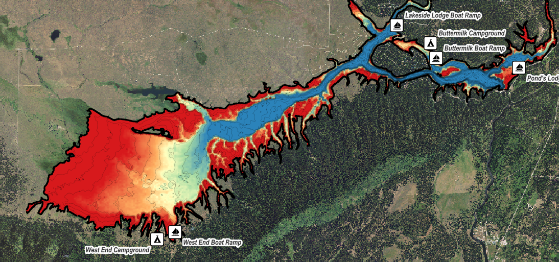

Island Park Reservoir Bathymetric Map
Process | Results | Application
Dr. Jack McLaren | Aquatic Ecology Program Manager
IDEQ Water Quality Workshop | March 2025

Slide 2
Takeaways
Process: The HFF made a digital elevation model of Island Park Reservoir with simple tools

Slide 3
Takeaways
Process: The HFF made a digital elevation model of Island Park Reservoir with simple tools
Results: useful, but resulting map and statistics area subject to measurement error

Slide 4
Takeaways
Process: The HFF made a digital elevation model of Island Park Reservoir with simple tools
Results: useful, but resulting map and statistics area subject to measurement error
Application: Disseminating real-time information about water levels and water quality has proven popular and useful for recreation and science

Slide 5
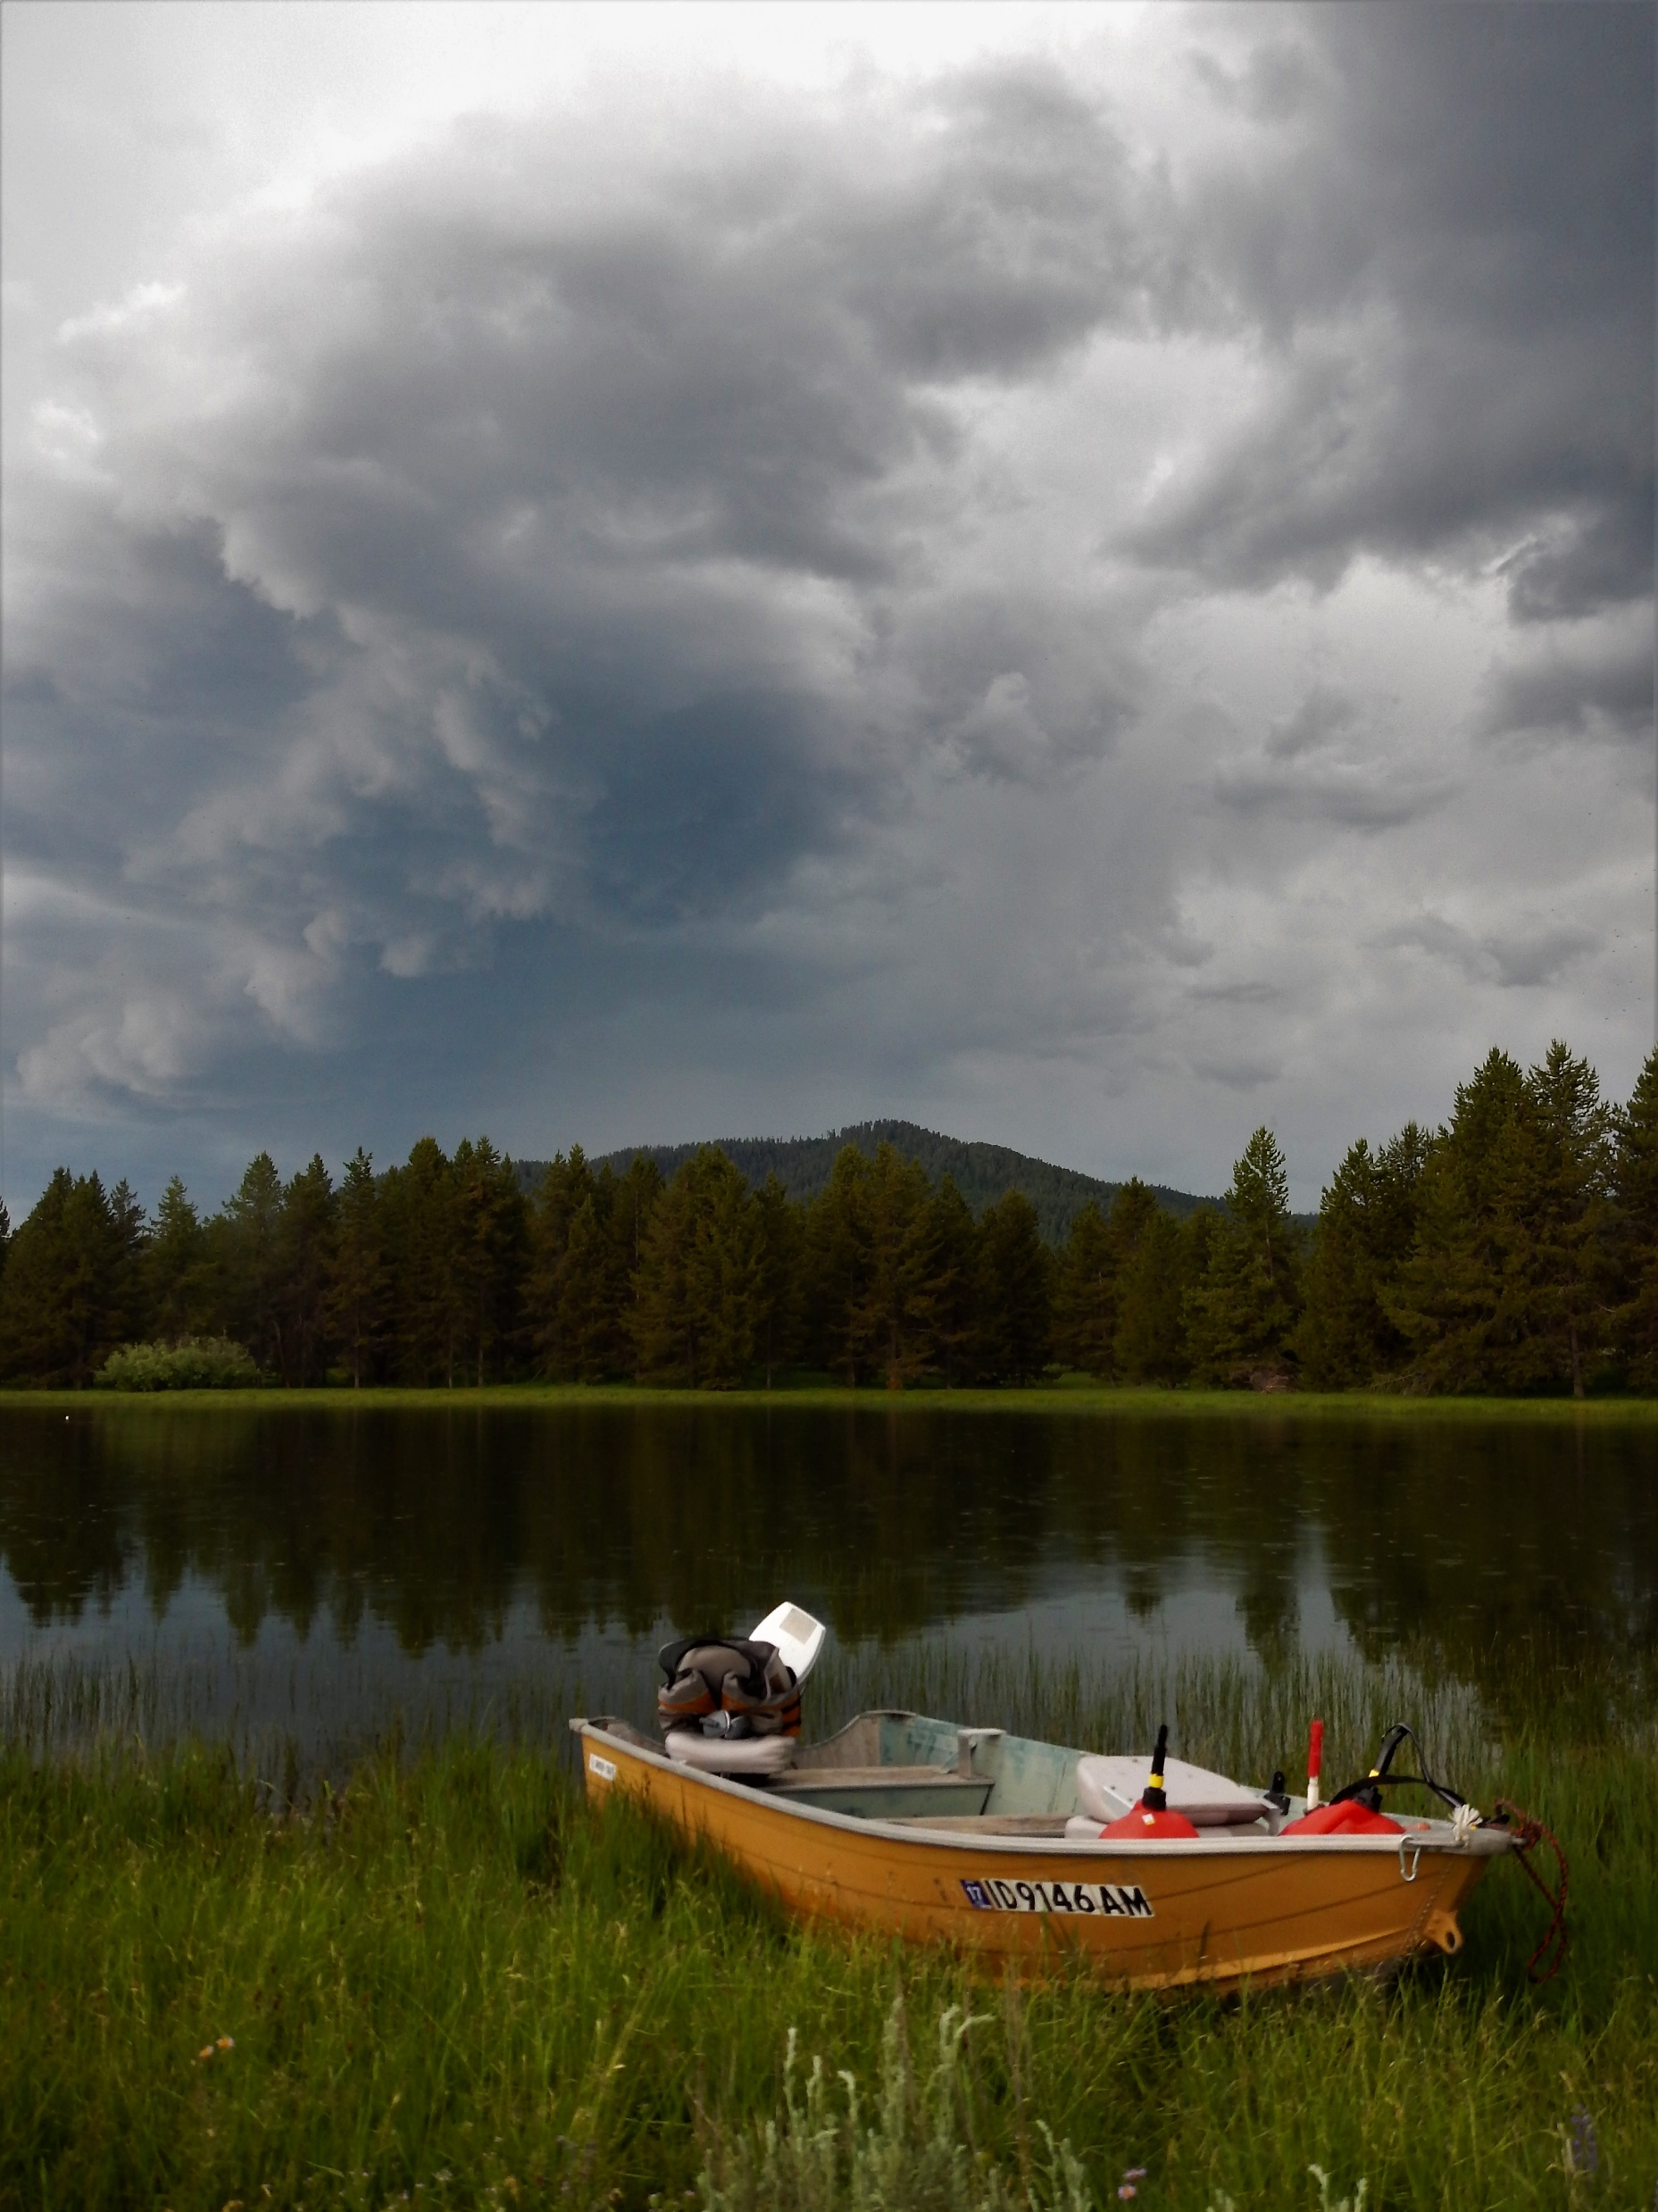
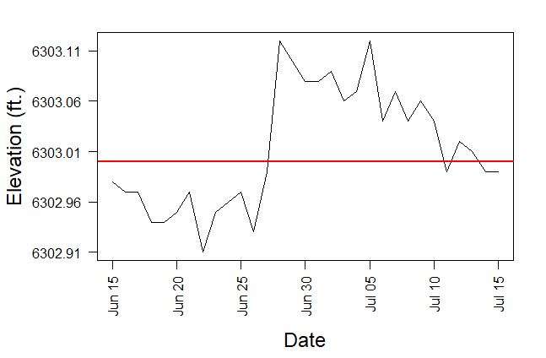
Process
Lowrance GPS sonar & small boat
June-July 2017
2.5” maximum difference between days
~1 inch above or below full pool

Slide 6
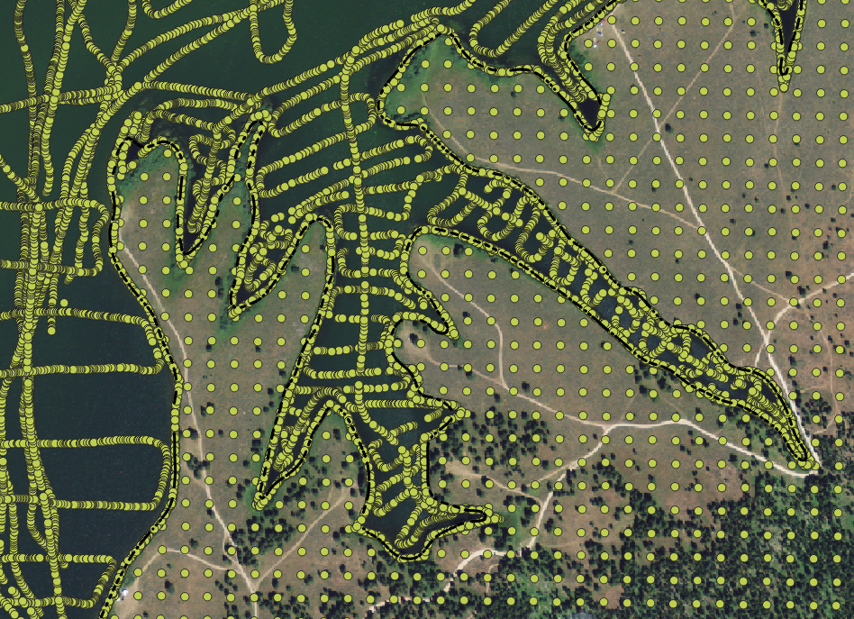
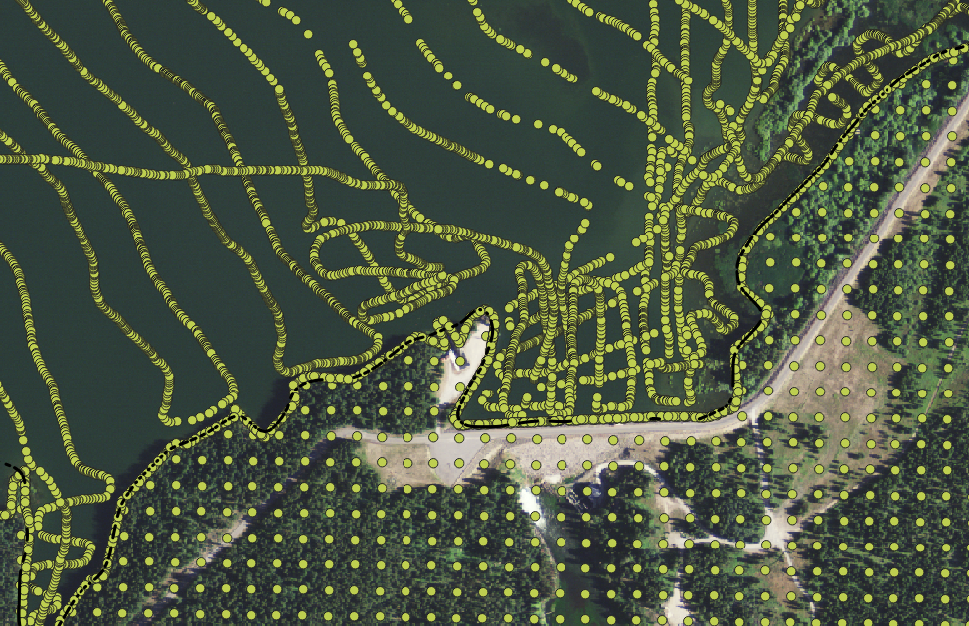
Process
200 m grid perpendicular to flow lines
Each point has depth and location data

Slide 7


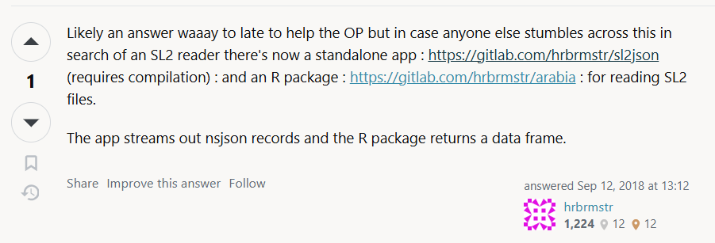
Process
Converted from .sL2 data (Lowrance proprietaray) to .gpx with conversion tool

Slide 8
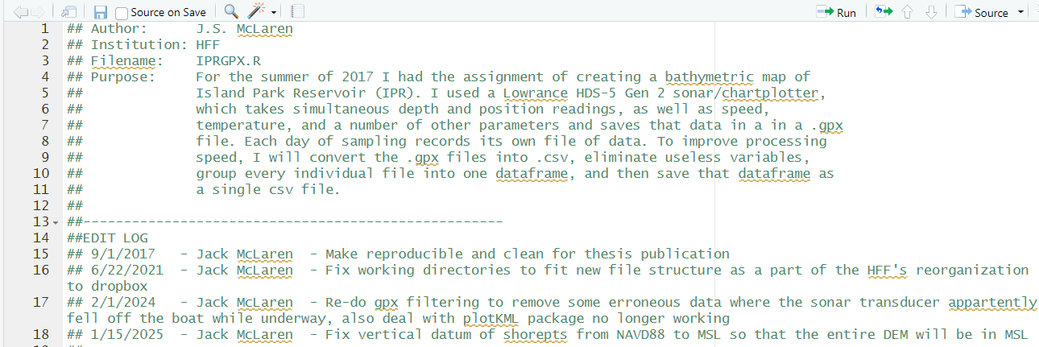
Process
R code
clean datapoints, subsample, calculate elevations
NAVD correction from MSL

Slide 9
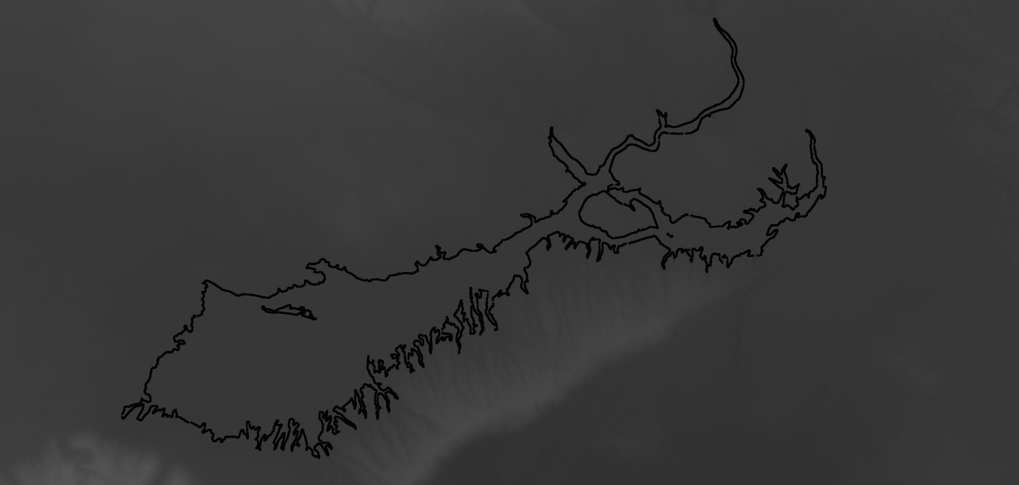
Process
Add subsample of surrounding 10 m DEM (USGS)
Add points representing the full-pool shoreline (6303 ft MSL)

Slide 10
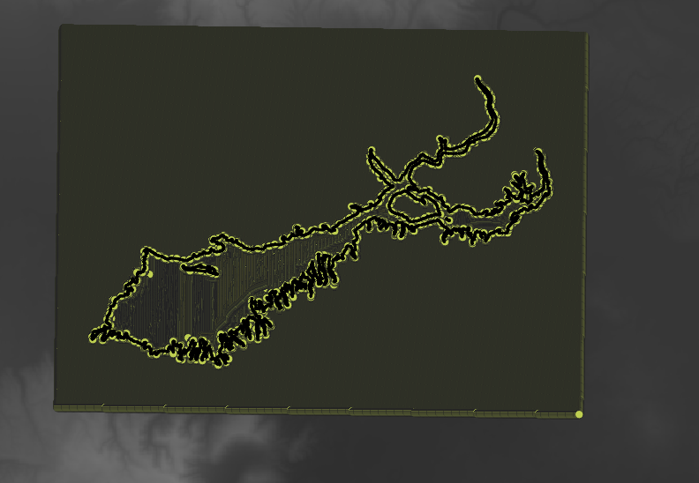
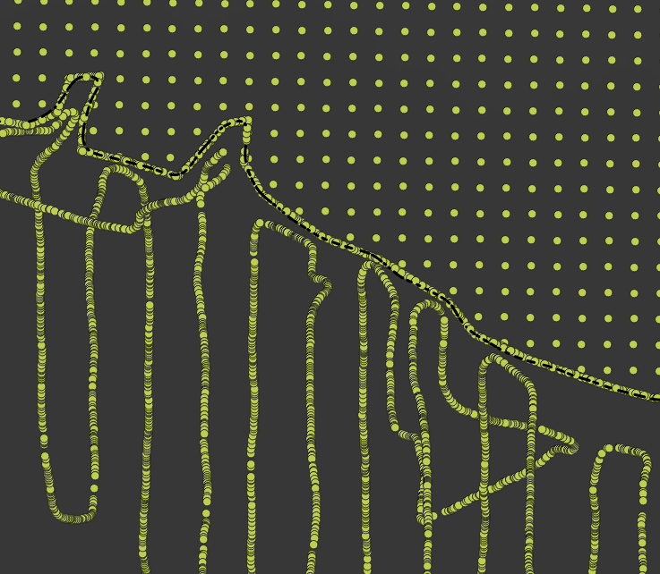
Process
Add subsample of surrounding 10 m DEM (USGS)
Add points representing the full-pool shoreline (6303 ft MSL)

Slide 11
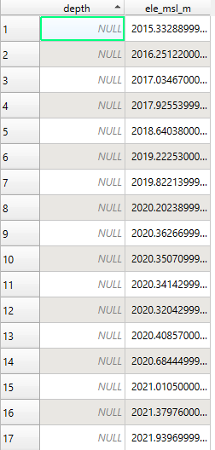
Process
Knit into single dataset
621,585 datapoints (399,667 within the lake)
Removed data from ingoing/outgoing trips + obvious erroneous data

Slide 12
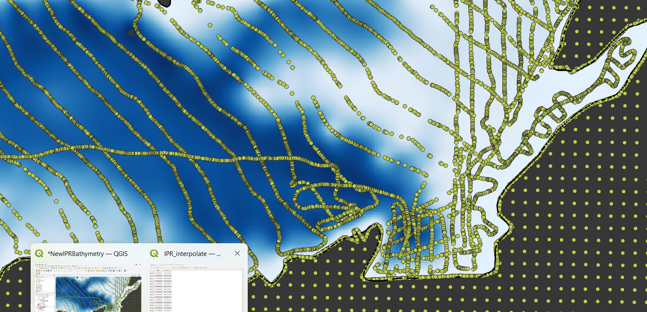
Process
QGIS
B-spline interpolation to create DEM surface

Slide 13
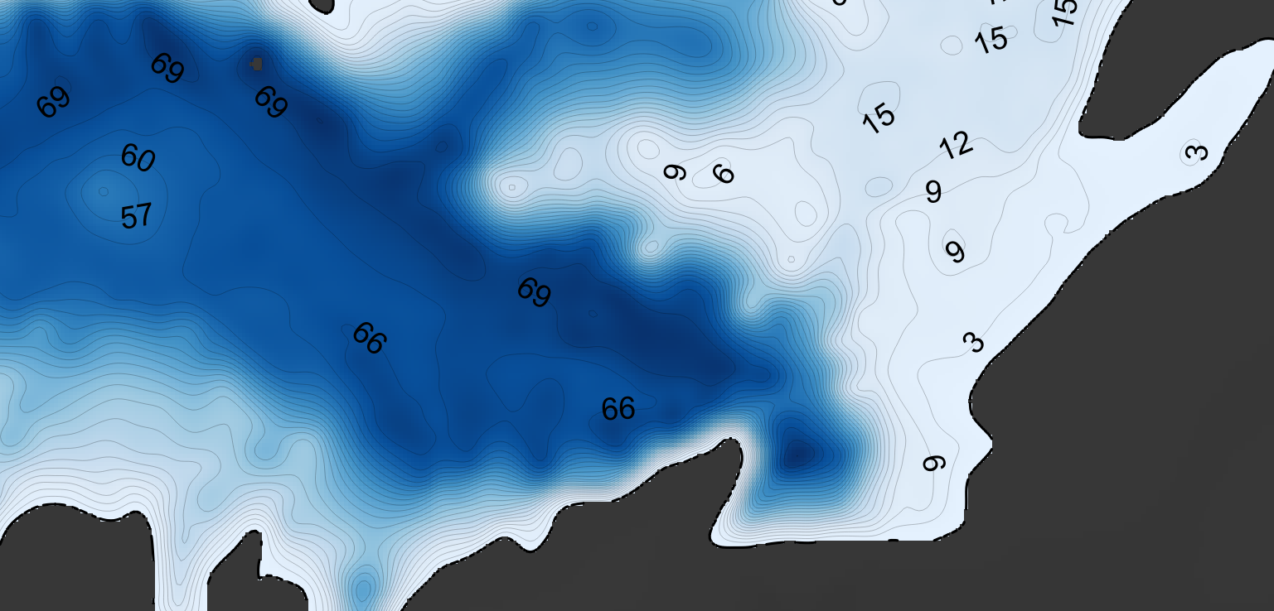
Process
QGIS
B-spline interpolation to create DEM surface
Use DEM surface to create contours

Slide 14

Process
QGIS
B-spline interpolation to create DEM surface
Use DEM surface to create contours
Symbology, roads, access points, etc.

Slide 15
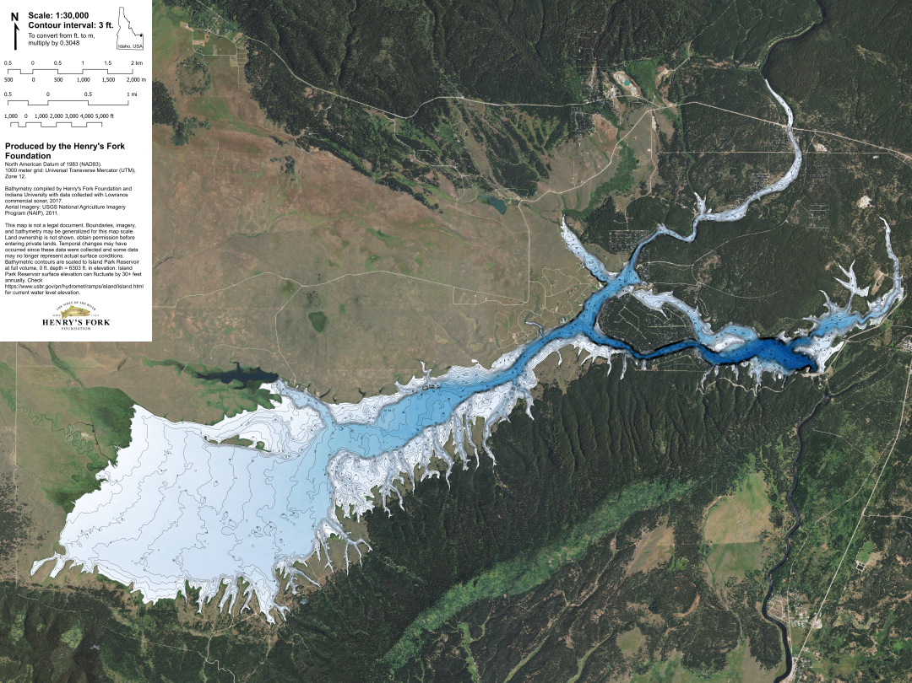
Process (final product)
Data sources:
Open street maps roads
NAID aerial imagery (2011)
Hillshading from USGS DEM

Slide 16
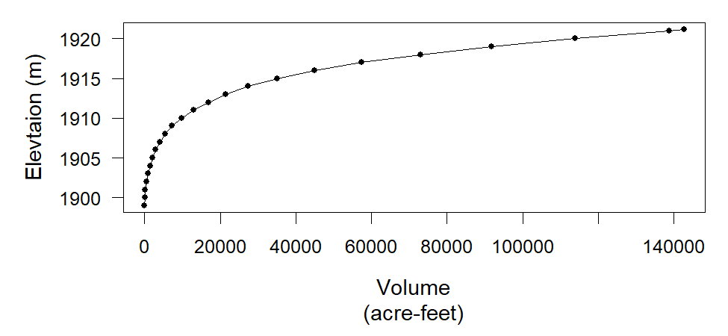
Results-Morphometry
Full Volume | ~130,000 acre-feet (Error discussion next slide!)
Shoreline length | 109 miles
Shoreline development | 8.87 (bias-corrected 6.17)
Mean Depth | ~16.5 feet
Area | 7830 acres
Water residence time
Vollenweider trophic state
Littoral area
Thermal stability
CEQUAL-W2 model
Etc.

Slide 17
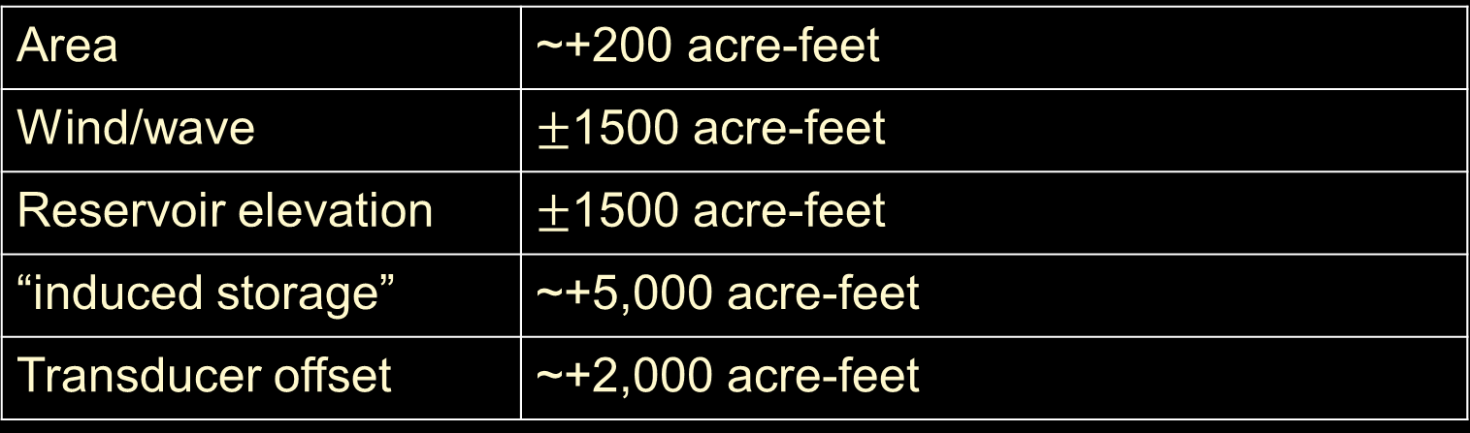
Results-Error discussion
Area | ~+200 acre-feet
Wind/wave | $±$1500 acre-feet
Reservoir elevation | $±$1500 acre-feet
“induced storage” | ~+5,000 acre-feet
Transducer offset | ~+2,000 acre-feet

Slide 18
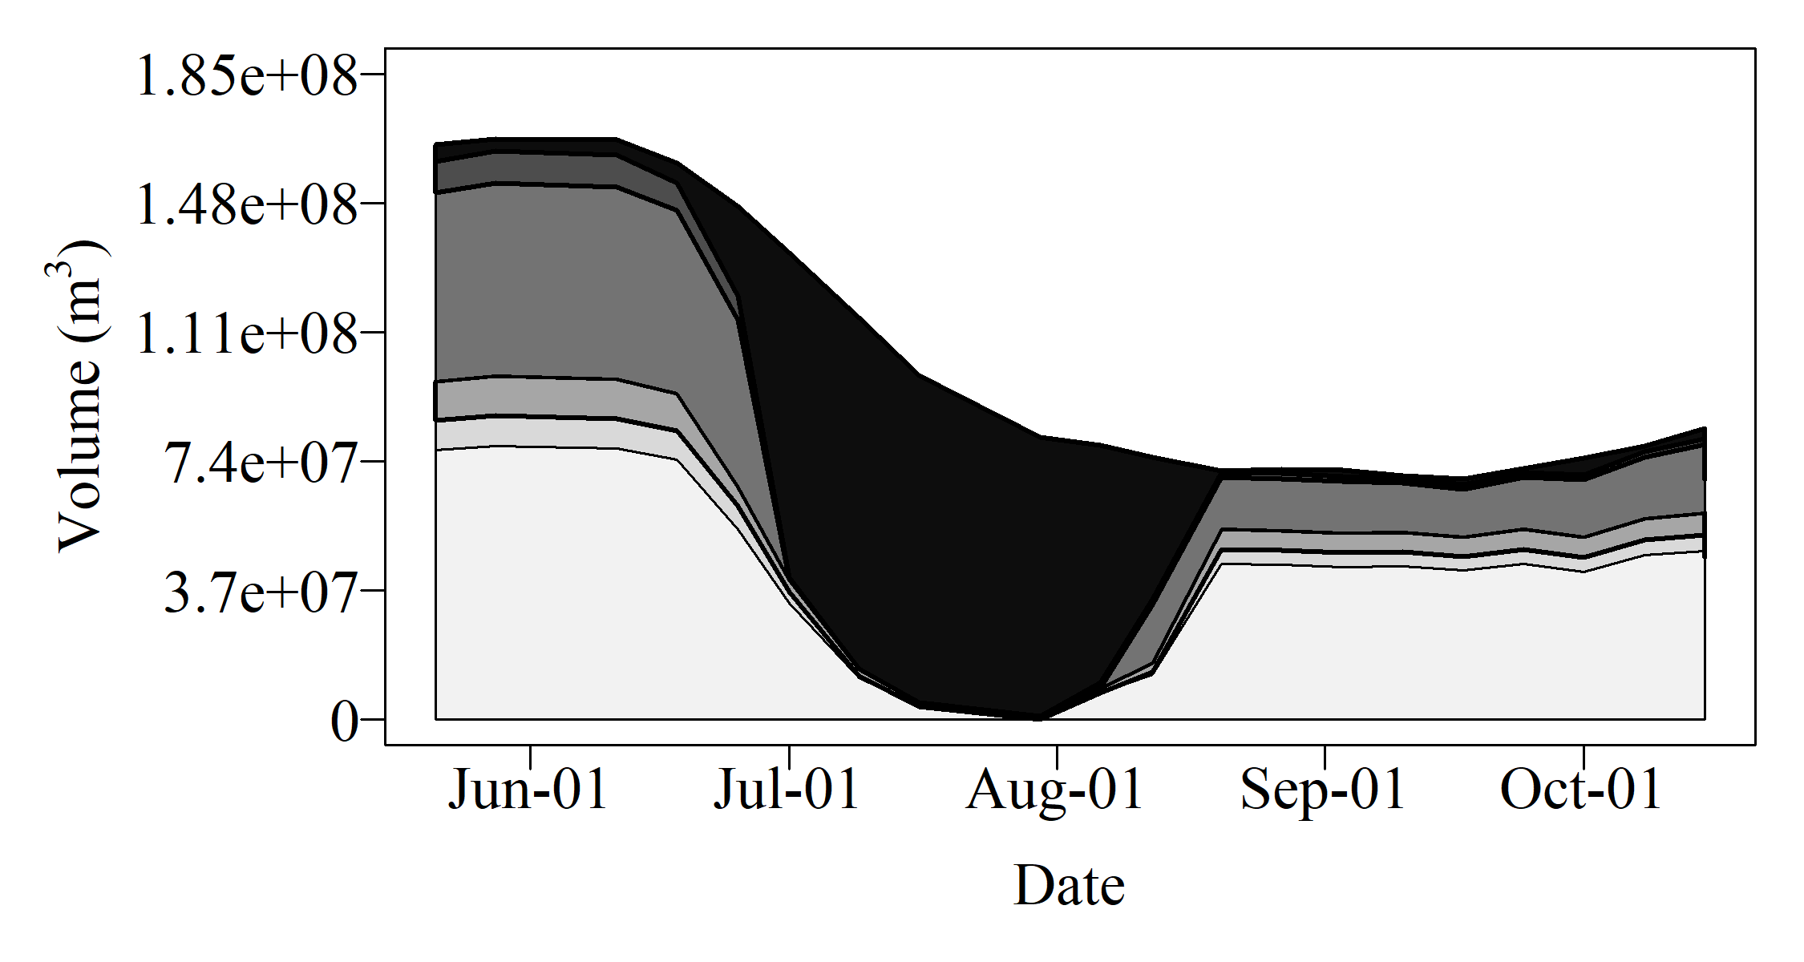
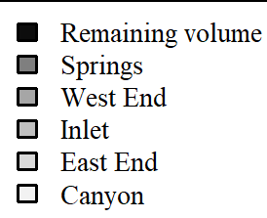
Application
Scientific:
Habitable volume for fish

Slide 19
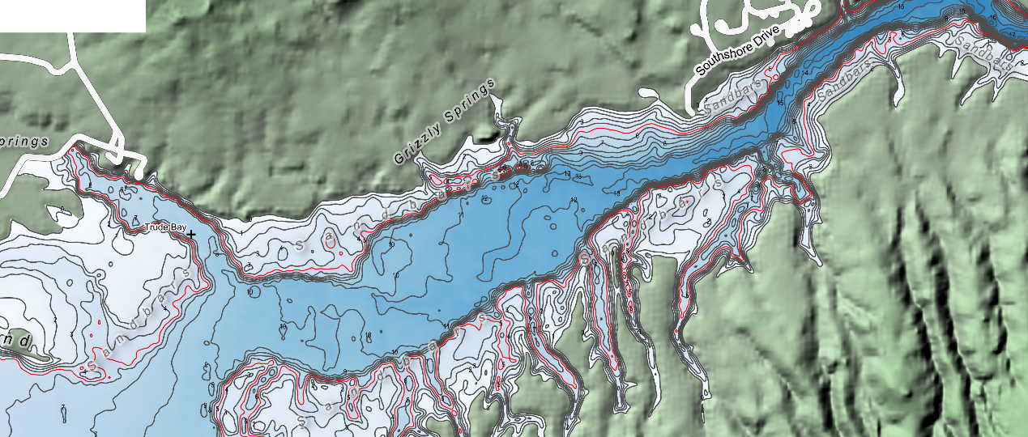
Application
Scientific:
Habitable volume for fish
Weekly data collection safety

Slide 20
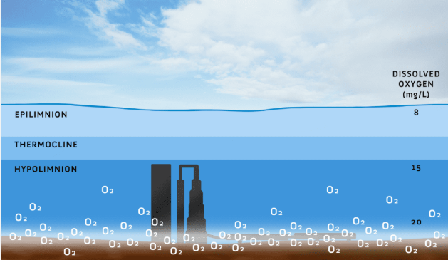
Application
Scientific:
Habitable volume for fish
Weekly data collection safety
Future: Oxygenation and limnology
https://hurthwaterscapes.com/oxygen-saturation-technology/
Notes:
<say we want to calculate fish habitat volume and compare strategies: keeping IPR full vs. oxygenation vs. both>
Useful for contractors

Slide 21
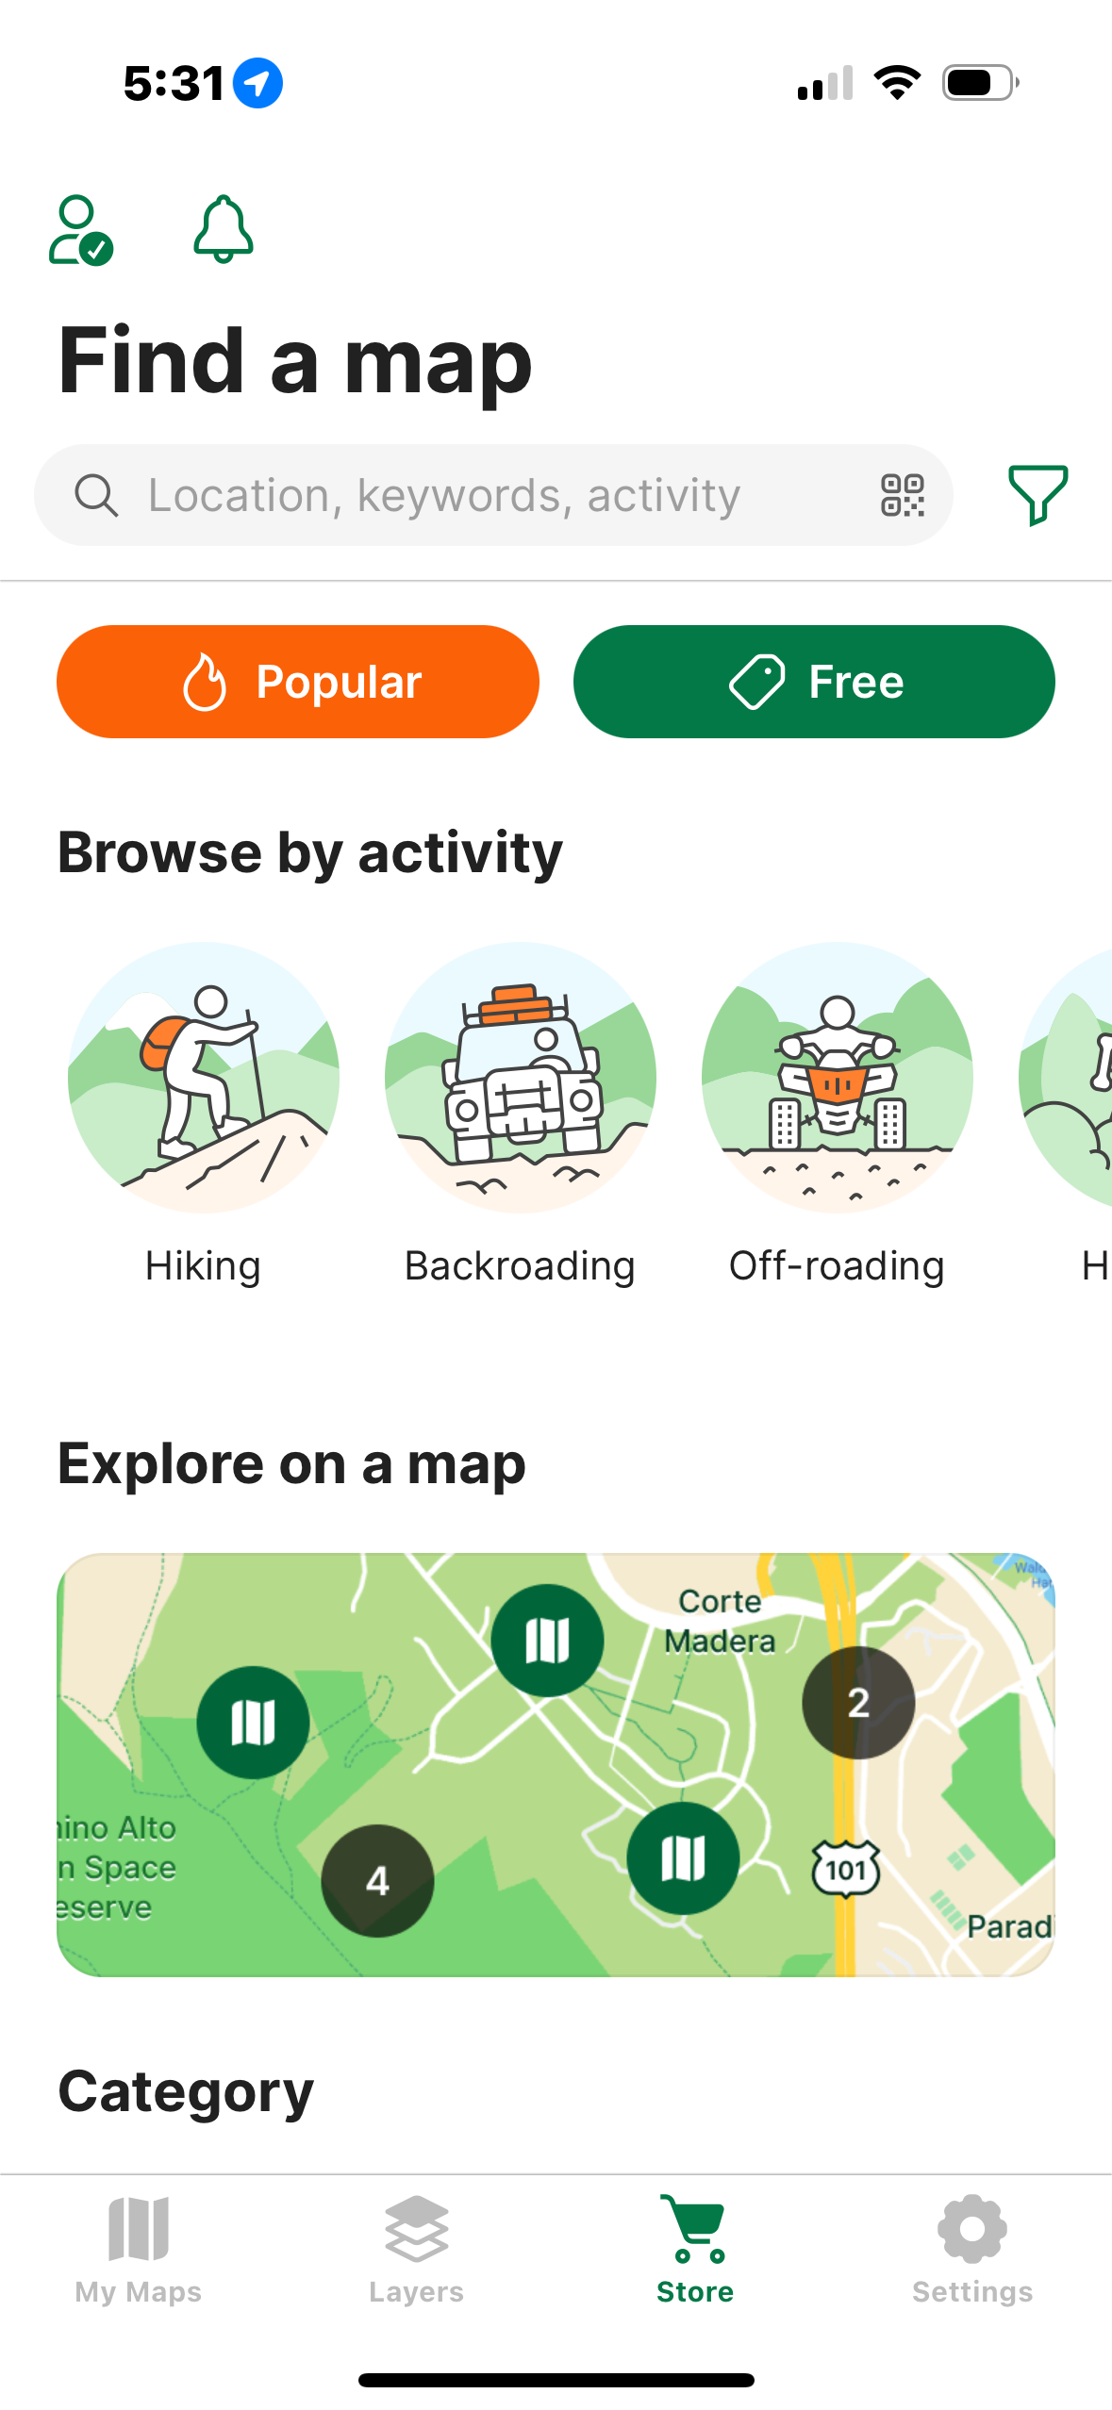
Application
Public information dissemination
Avenza map

Slide 22
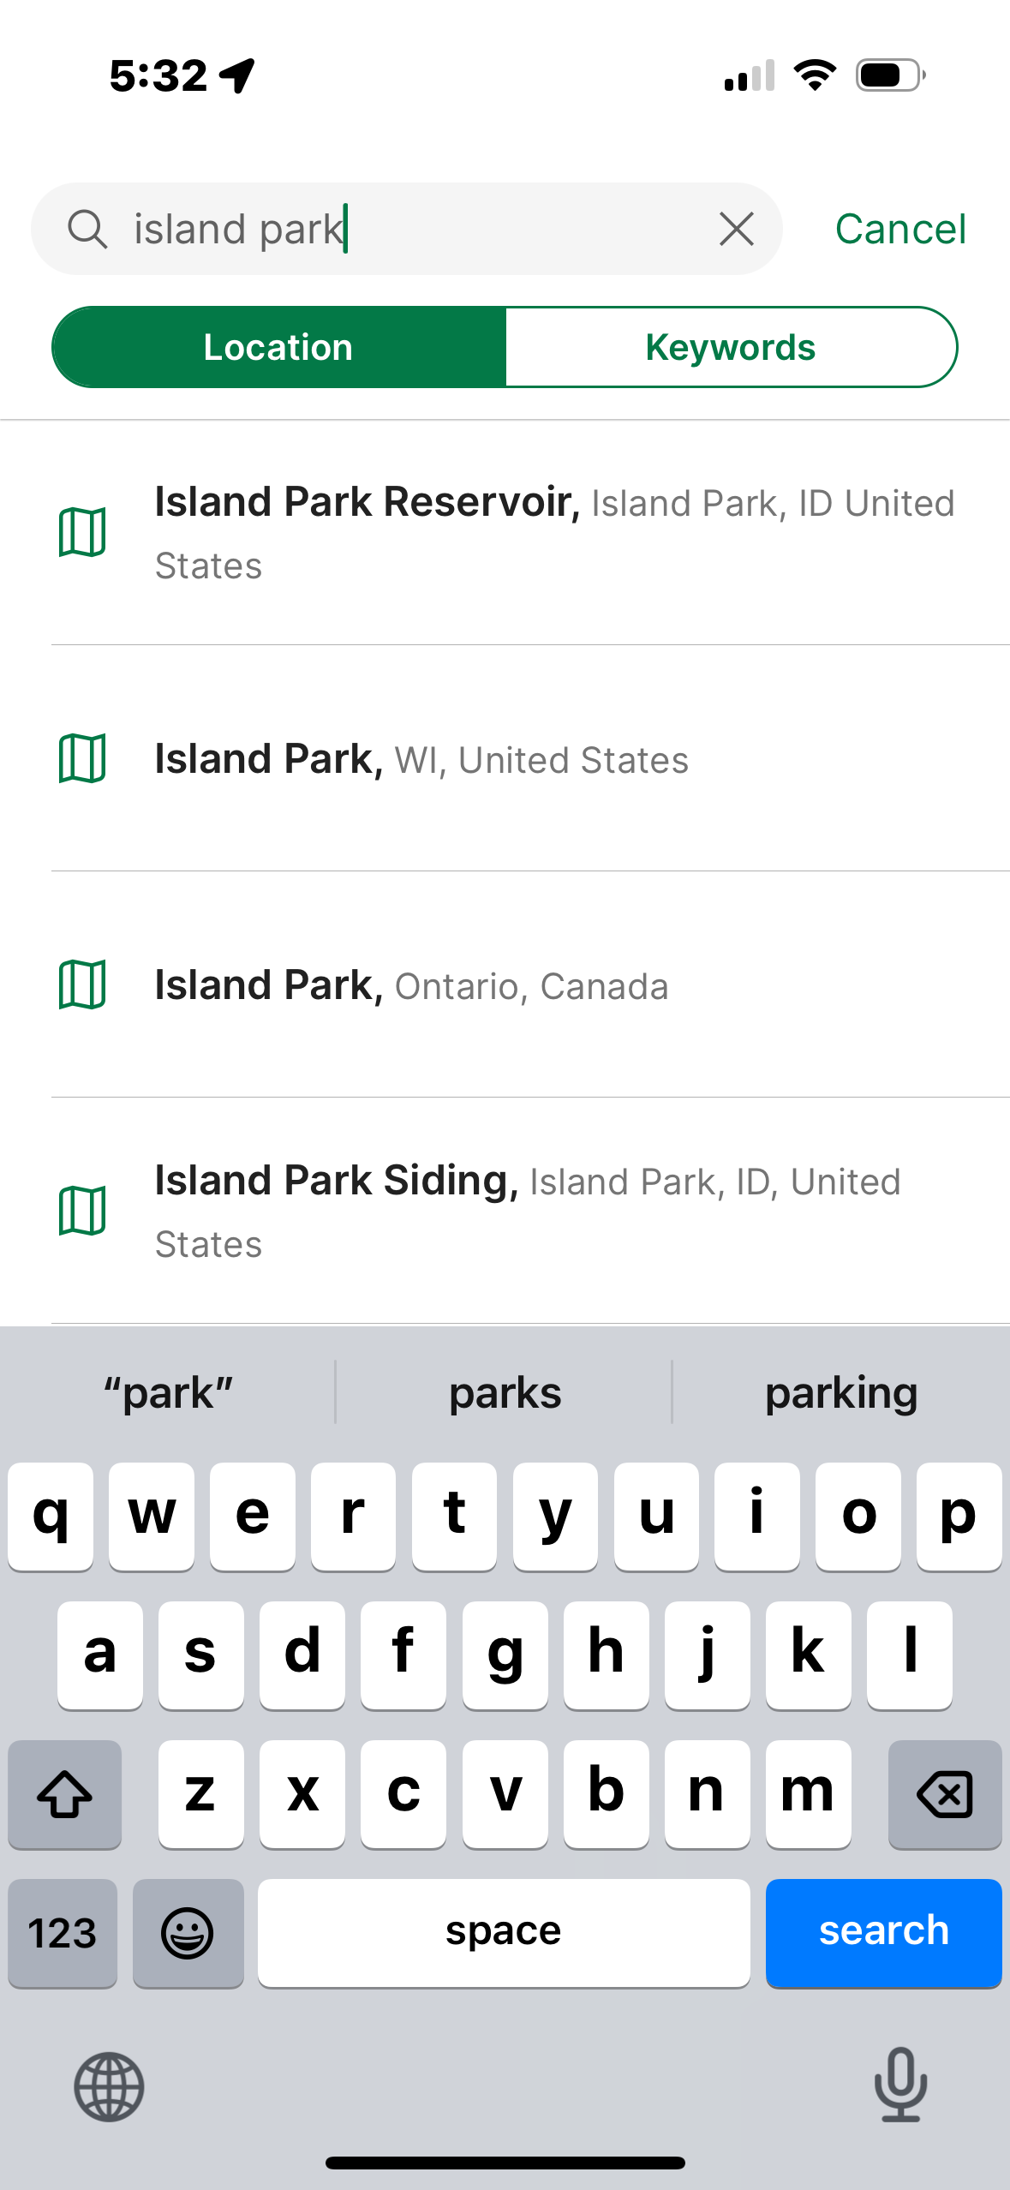
Application
Public information dissemination
Avenza map

Slide 23
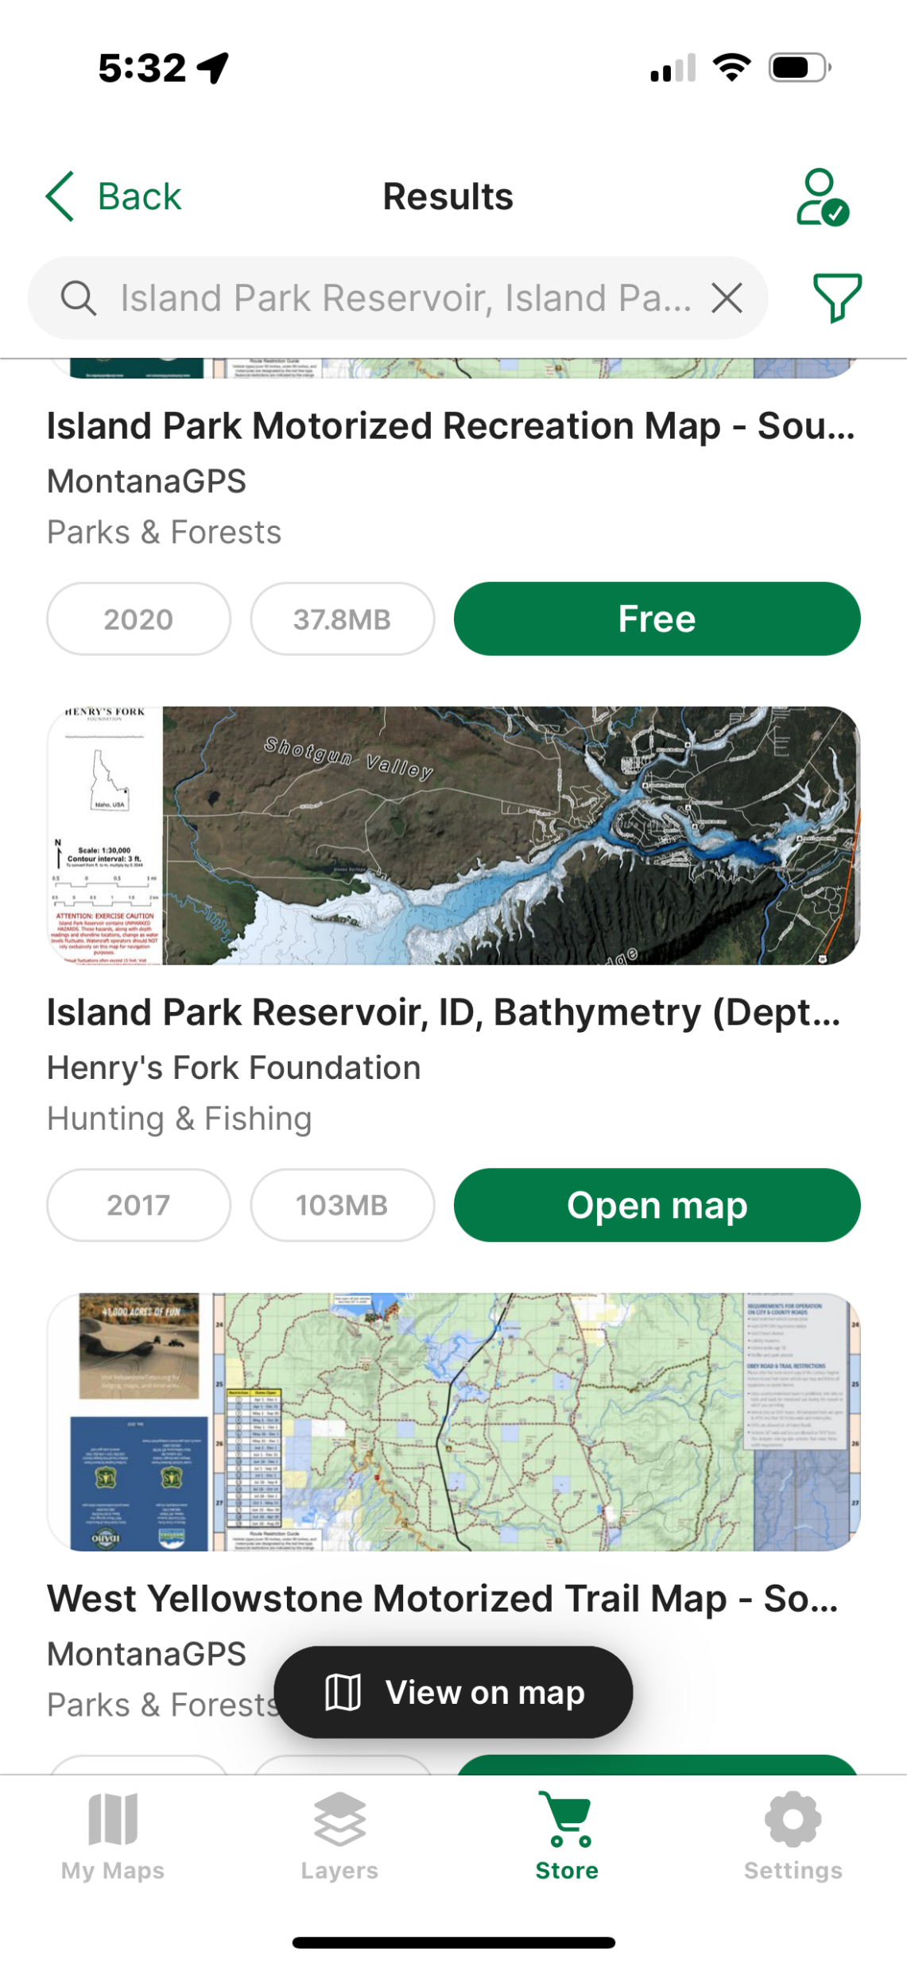
Application
Public information dissemination
Avenza map

Slide 24
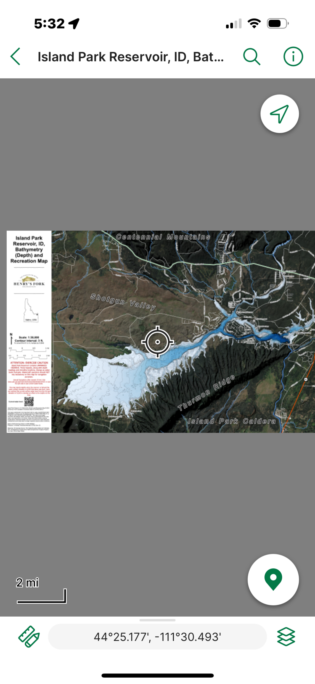
Application
Public information dissemination
Avenza map

Slide 25
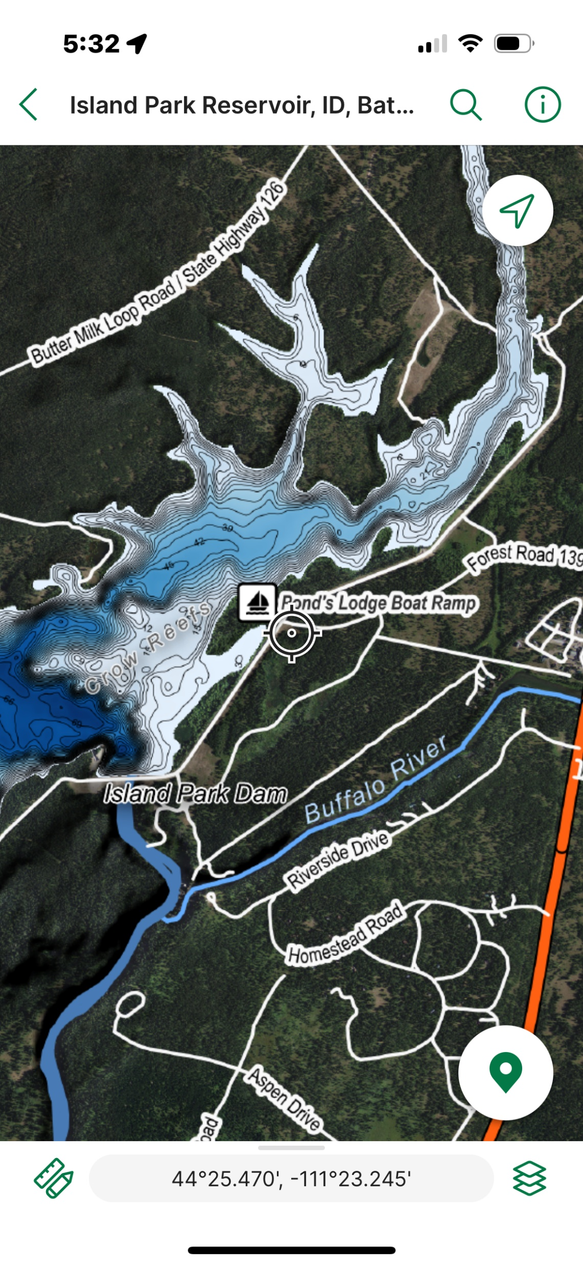
Application
Public information dissemination
Avenza map

Slide 26
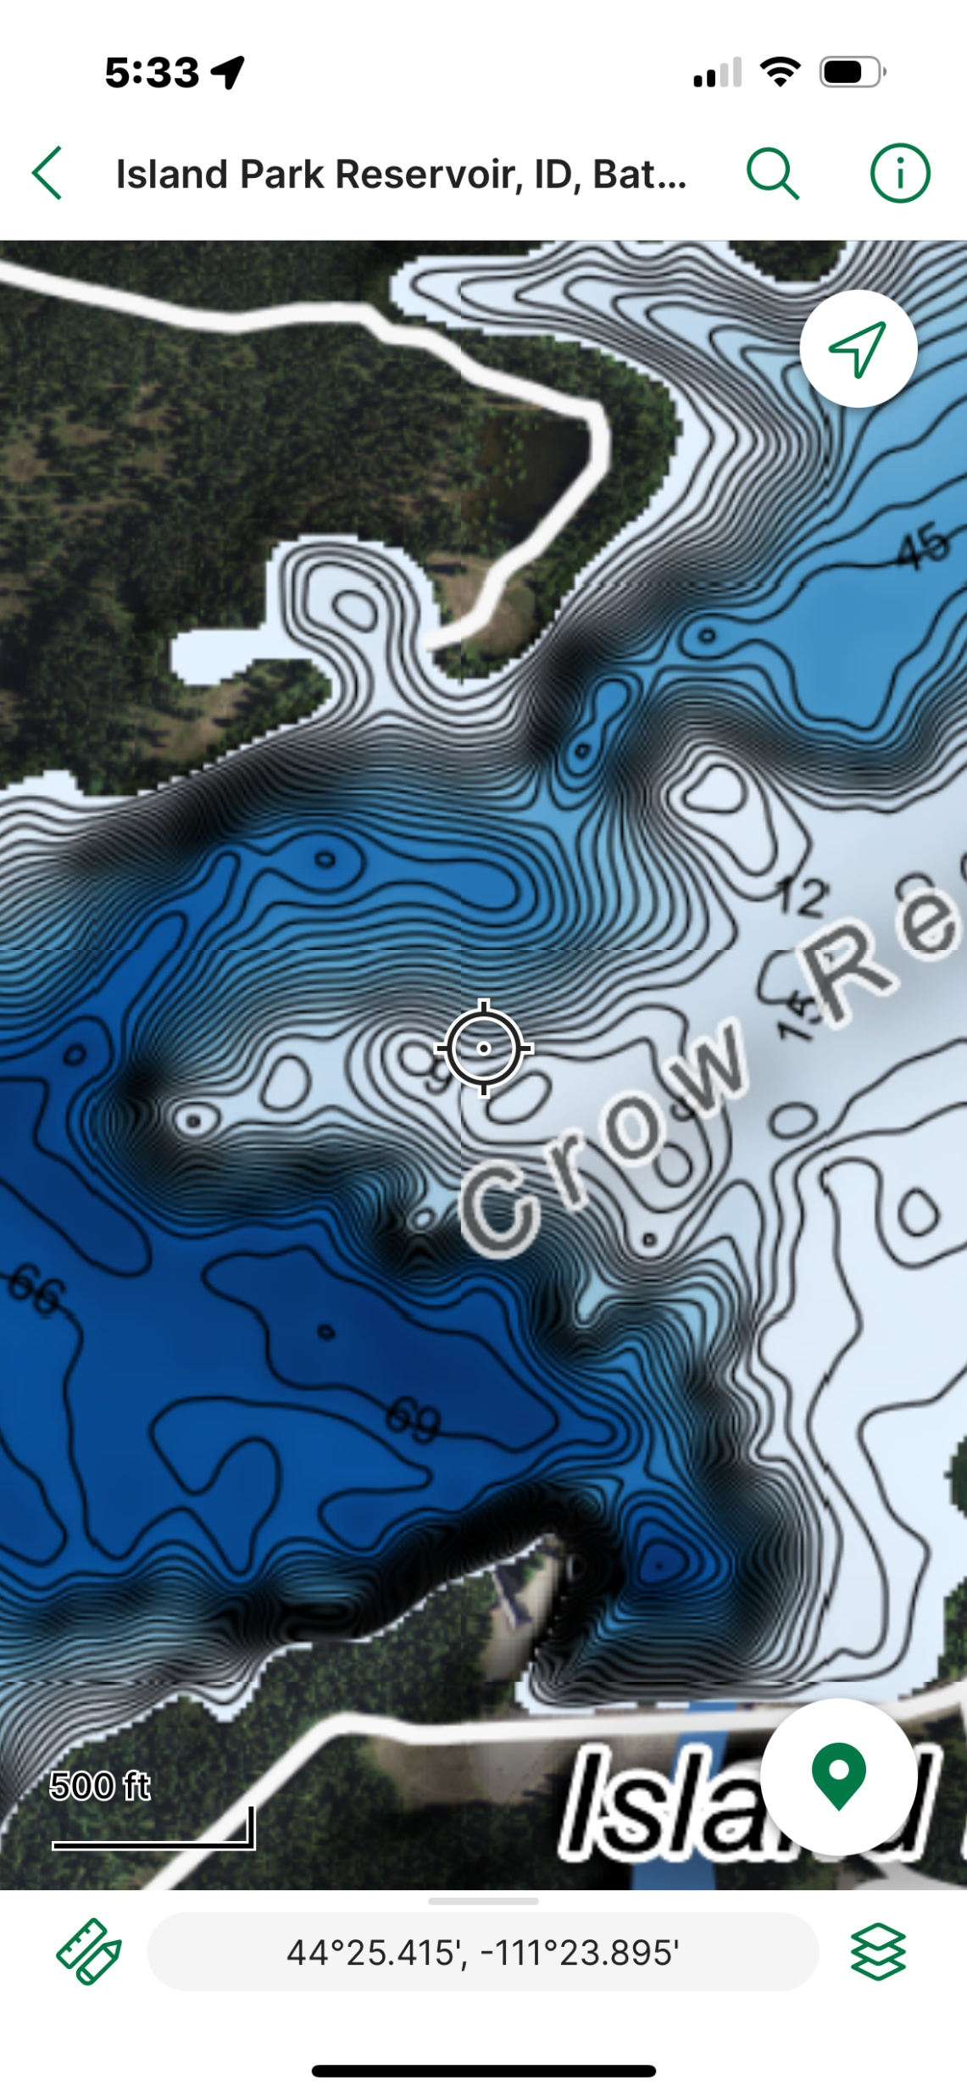
Application
Public information dissemination
Avenza map

Slide 27
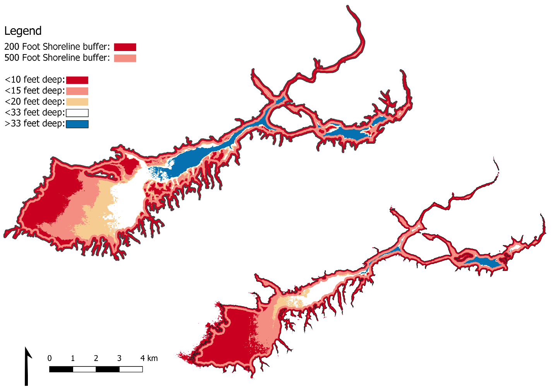
Application
Public information dissemination
Avenza map
Dynamic map on IP reservoir data website
Notes:
<show dynamism with declining water level>
One-stop shop for water level, water quality, maybe health advisory information too?

Slide 28
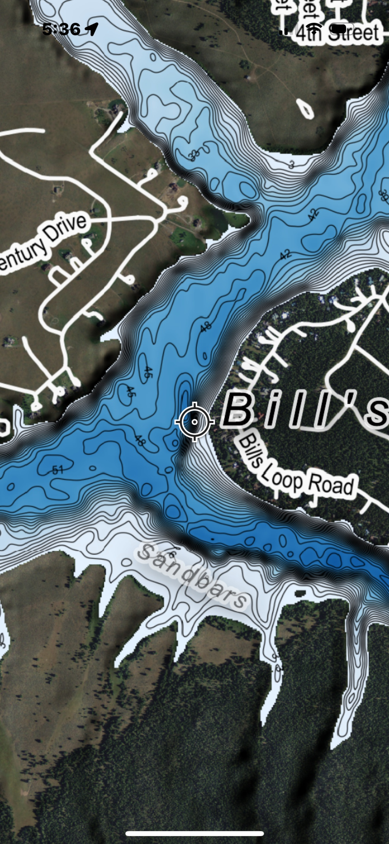
Application
Public information dissemination
Avenza map
Dynamic map on IP reservoir data website
Angling
Notes:
<show dynamism with declining water level>
One-stop shop for water level, water quality, maybe health advisory information too?

Slide 29
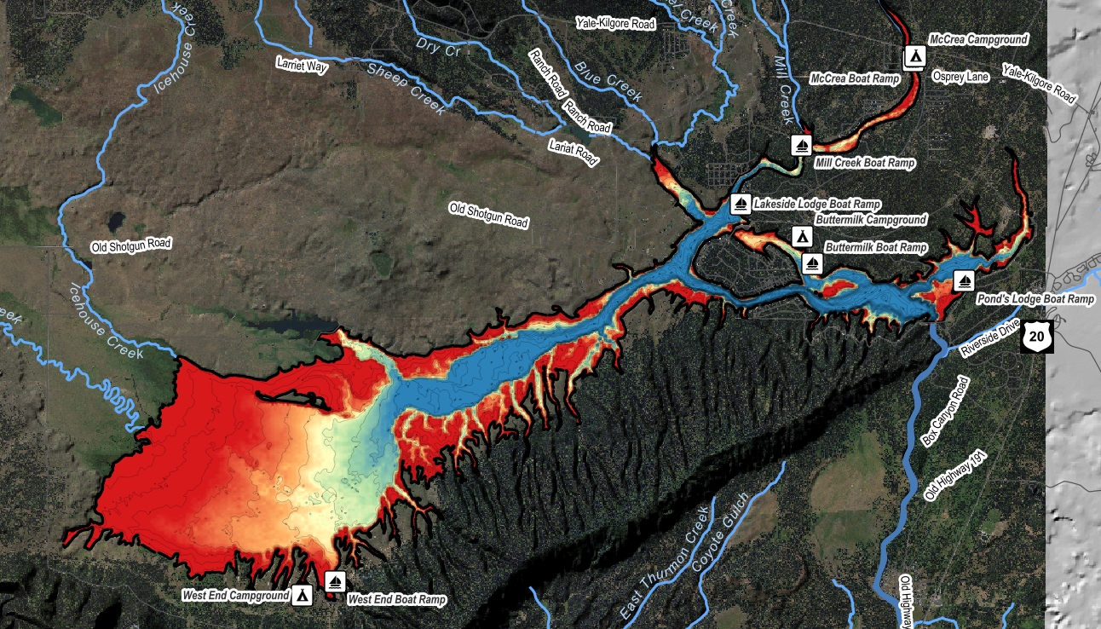
Application
Public information dissemination
Avenza map
Dynamic map on IP reservoir data website
Angling
Safe recreation
Notes:
<show dynamism with declining water level>
One-stop shop for water level, water quality, maybe health advisory information too?

