Slide 1
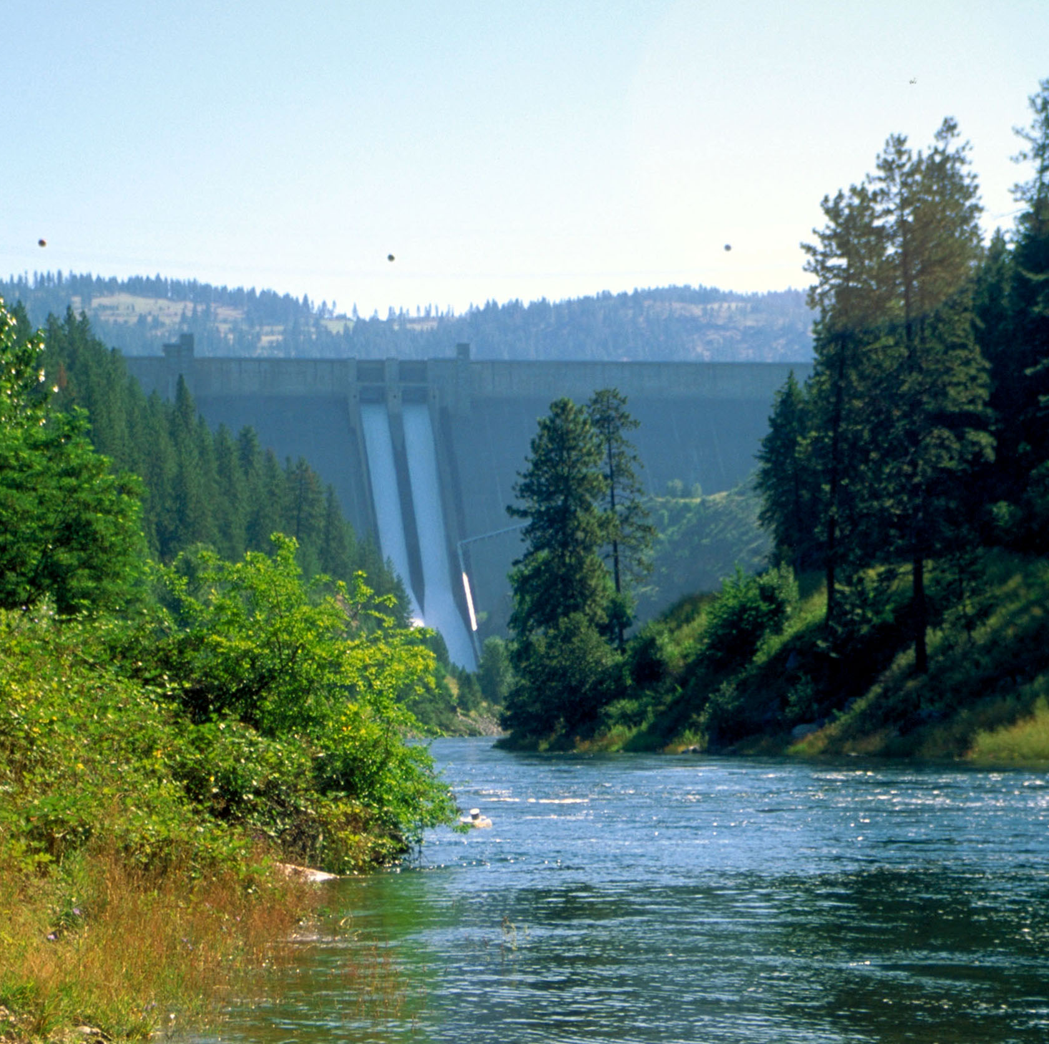

Water Right Administration in the Henry’s Fork Basin
Presented by James Cefalo
March 11, 2025

Slide 2
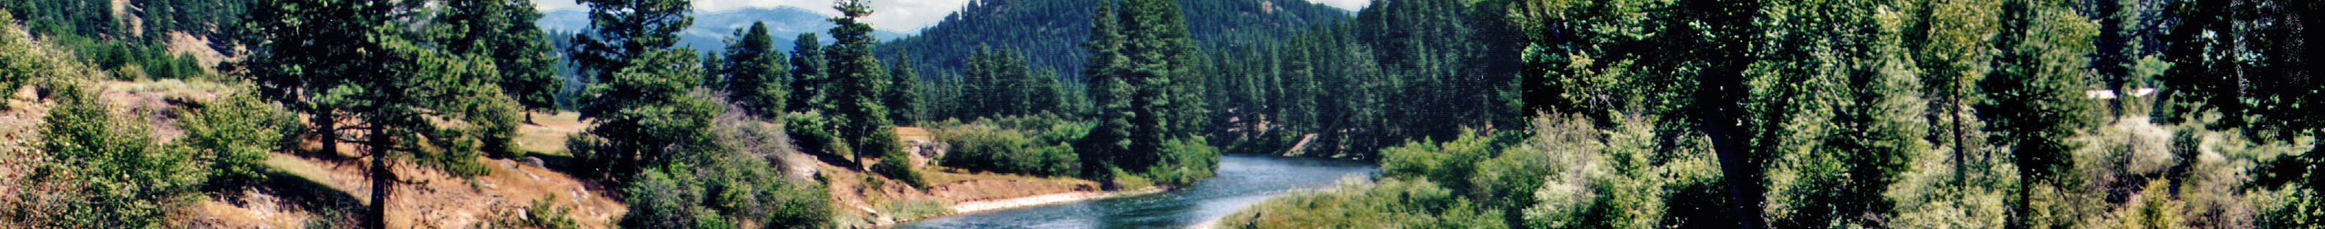

Water Districts
Created by the Idaho Department of Water Resources.
Primary function is to measure and report water diversions in the district and to deliver water in priority during times of scarcity.
Water districts are self-funded through annual assessments paid by water users in the district.
There are dozens of water districts in Eastern Idaho. Some regulate surface water rights, some regulate ground water rights, and some regulate both.

Slide 3
Creating Water Districts
Water districts are required by law. Idaho Code § 42-604 states:
“The director shall divide the state into water districts … such that each public stream and tributaries, or independent source of water supply, shall constitute a water district.”
“The director may create, revise the boundaries of, or abolish a water district or combine two or more water districts by entry of an order . . . to properly administer uses of the water resource.”

Slide 4
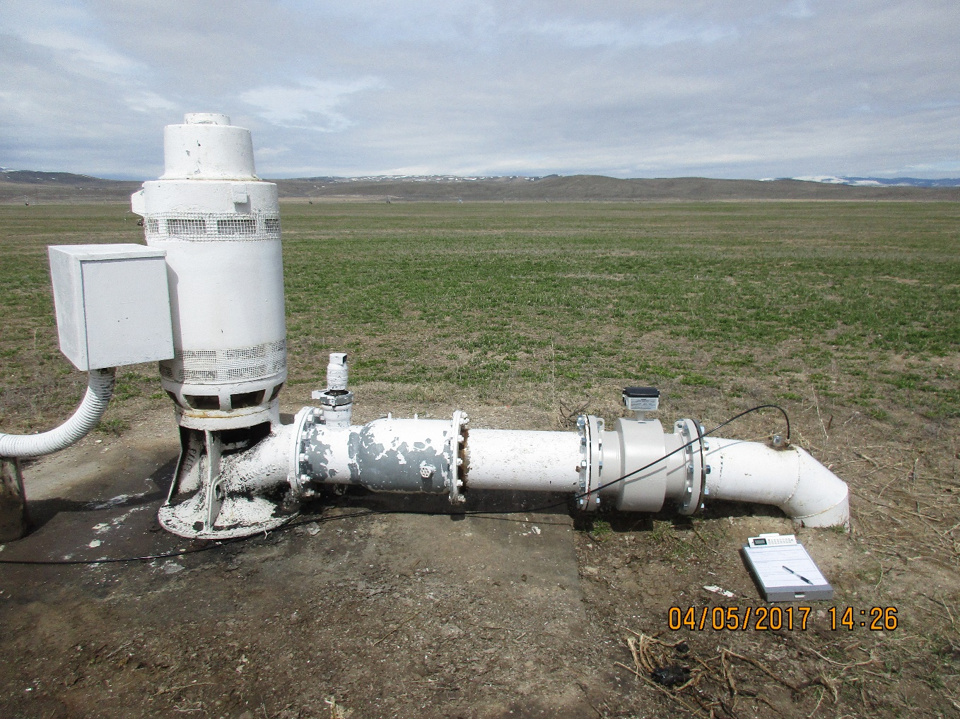
Water District Structure
Watermaster
Elected by water users, appointed by IDWR
Compensated through the assessment of water users
Receives guidance and training from IDWR
Measures and reports water uses within district
Helps IDWR identify and curtail unauthorized water uses.
Treasurer
Elected by water users to oversee collection and distribution of district funds.
Advisory Committee
Appointed by water users at annual water district meeting
Provides guidance and direction to watermaster and reviews water district records

Slide 5
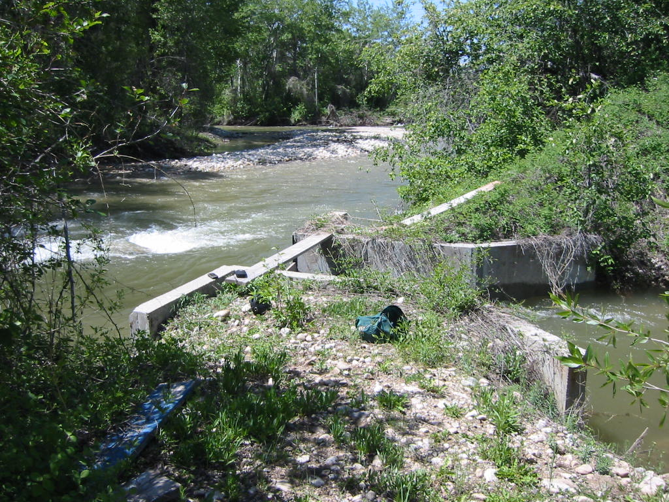
Water Districts for Surface Water Rights in the Henry’s Fork Basin
Water District 1 – Active Regulation
Large reservoirs: Henry’s Lake, Island Park, Grassy Lake
Diversions on Henry’s Fork downstream of Warm River
Diversions on Teton River downstream of Highway 33 Bridge
Diversions on Fall River, Canyon Creek, and Conant Creek
Deputy watermaster regulates
larger diversions in Upper Teton River
Water District 1 – Unregulated
Small diversions in Upper Teton River
Tributaries to the Teton River north of Leigh Creek
Diversions on Henry’s Fork and tributaries
upstream of Warm River

Slide 6
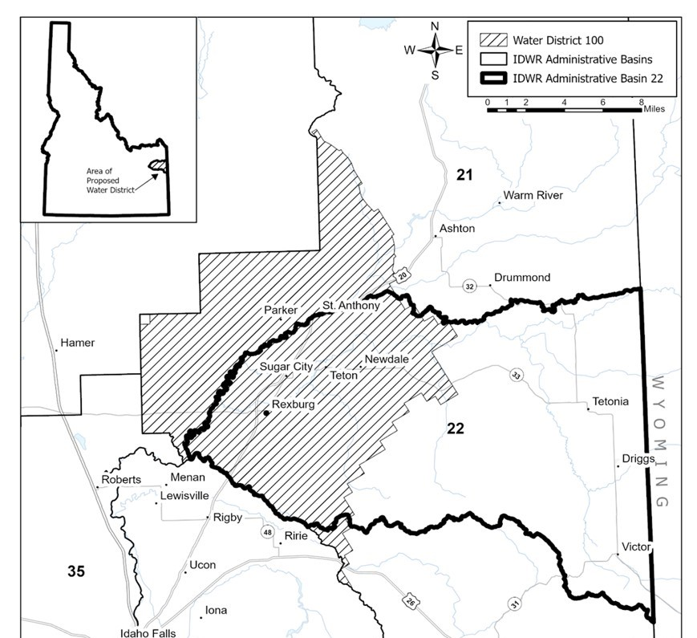
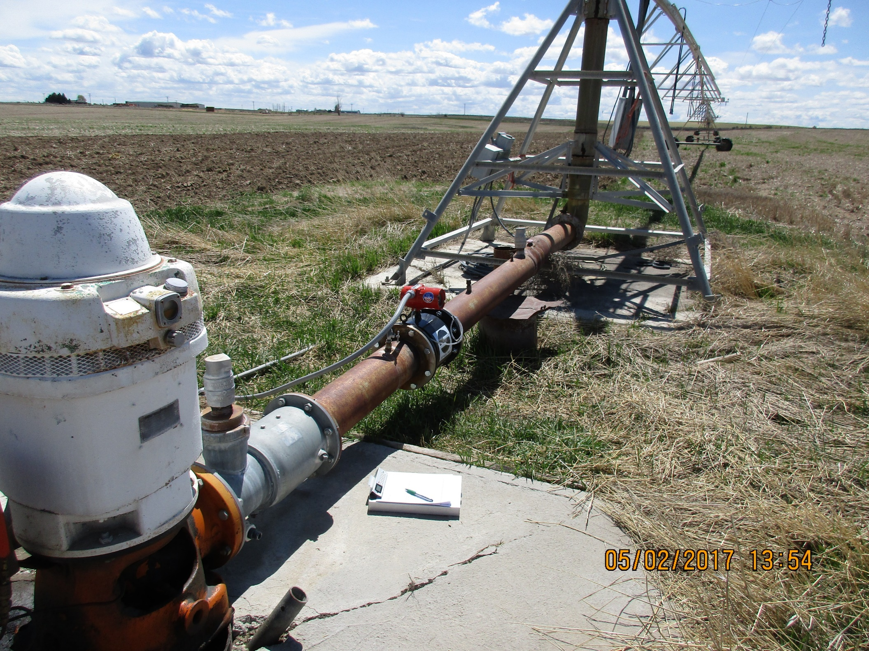
Water Districts for Ground Water Rights in the Henry’s Fork Basin

Slide 7
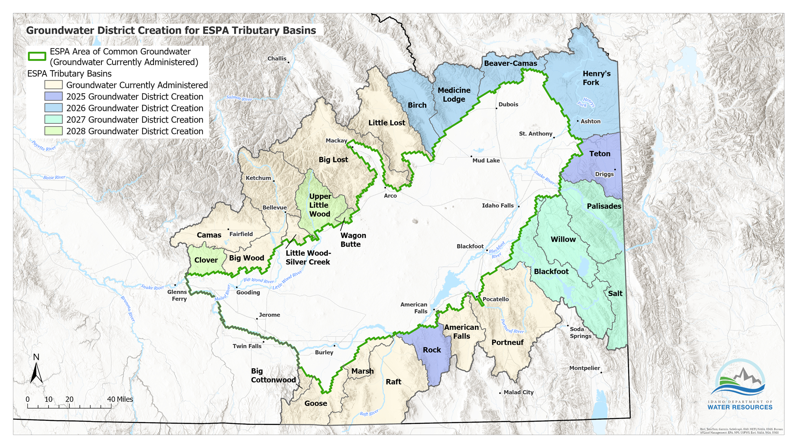

Slide 8
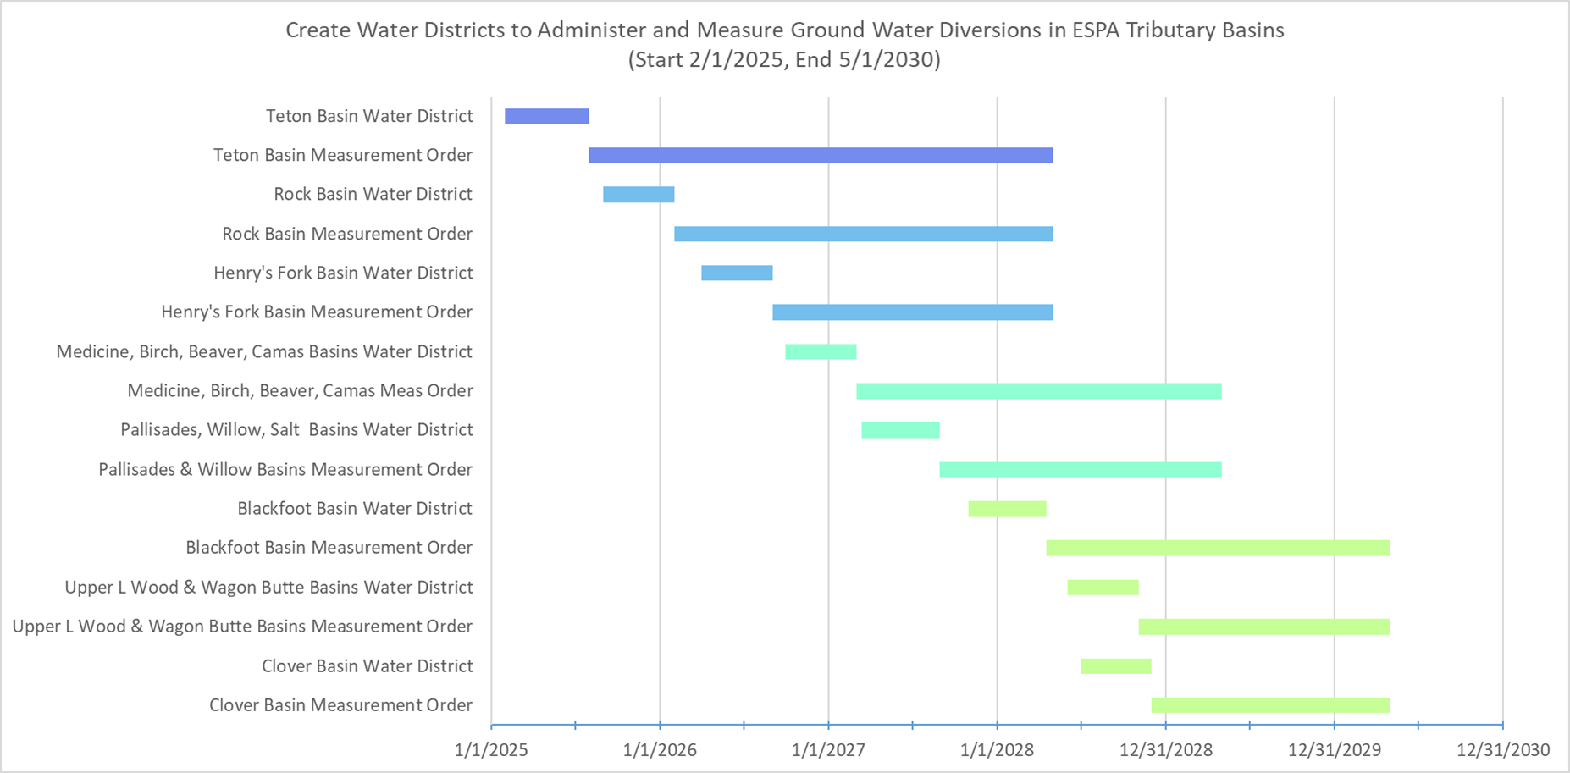

Slide 9
Creating or Modifying a Water District (Idaho Code § 42-604)
Informal public meeting to receive feedback about boundaries and make up of a proposed district.
IDWR creates a proposal for new water district.
IDWR sends notice of proposed action to each water user in the proposed district by mail or through legal advertisement.
Public hearing and period for written comment.
Order creating or amending the water district.
Appeals period for any challenges to IDWR action.

Slide 10
Creating a Water District to Administer Ground Water Diversions in Administrative Basin 22 (Teton River)
Public Information Meeting - March 5, 2025
Discussed options for creating a water district to administer ground water
1. Expand Water District 100 to include Basin 22
2. Create new water district for ground water rights
3. Expand Water District 100 and create new water district
3. Create new water district for surface and ground water rights
4. Create separate new water districts for surface and ground water rights

Slide 11
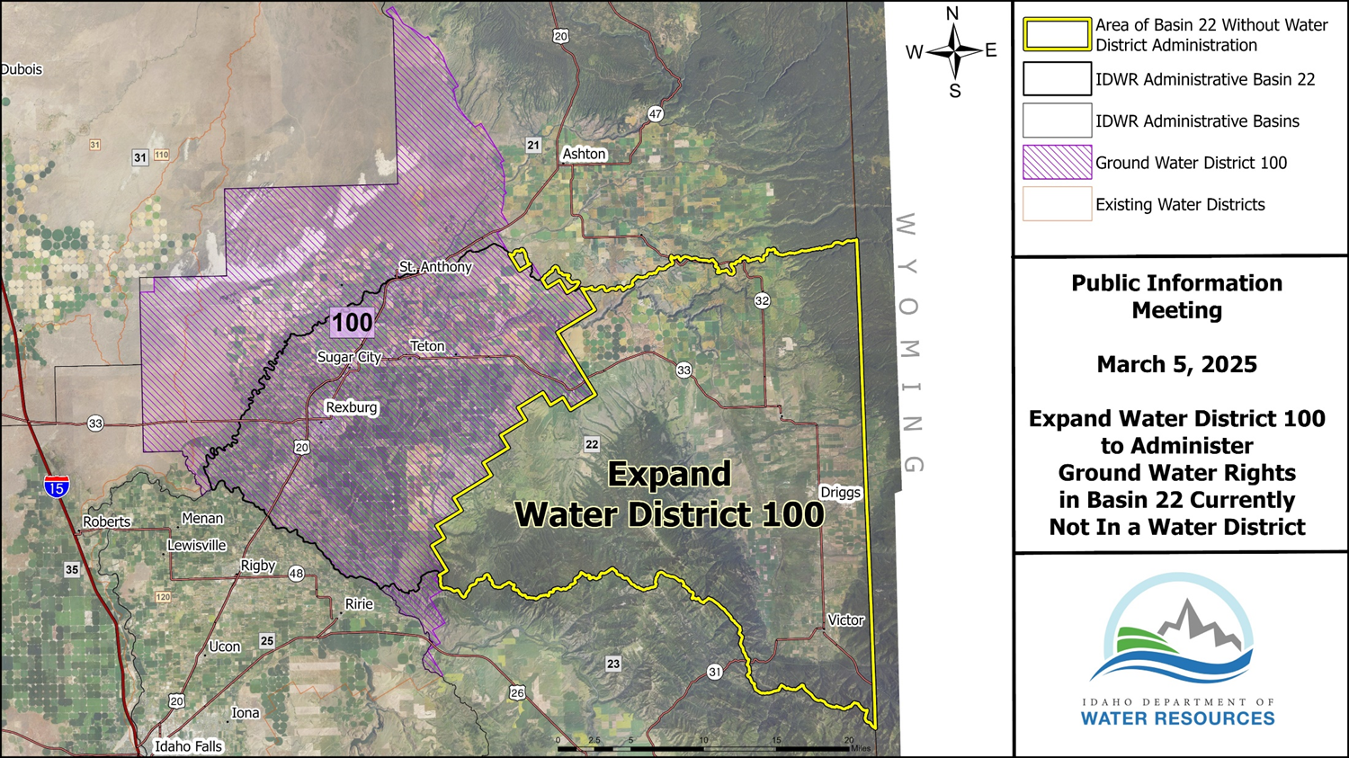

Slide 12
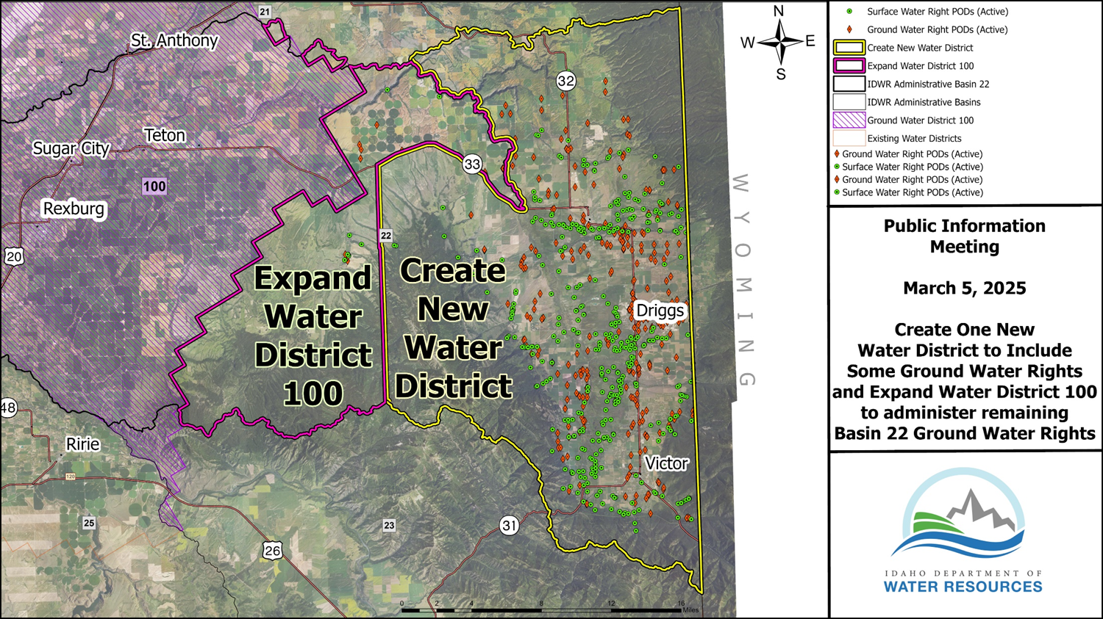

Slide 13
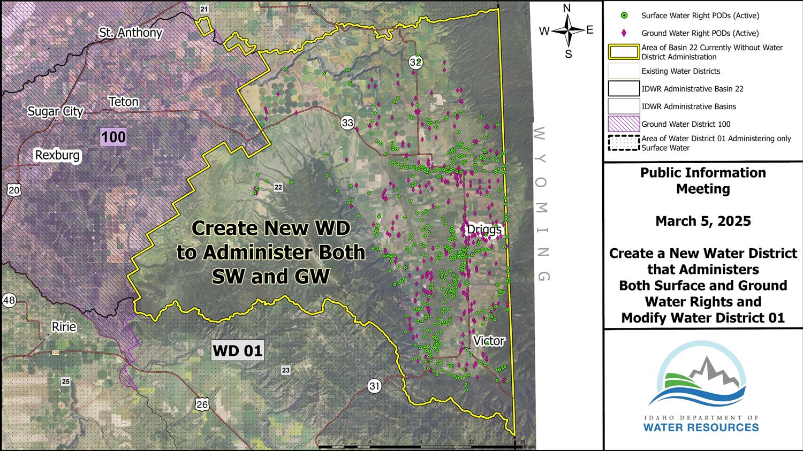

Slide 14
Next Steps for Creating Water District in Basin 22
IDWR will review notes from the public information meeting, will prepare an official proposal for creating or modifying water districts in Basin 22, and will distribute the proposal to water users who will be affected by the change. (Summer 2025)
IDWR will conduct a public hearing for the proposal. (Fall 2025)
Hearing officer will issue a final decision creating or modifying water districts based on the evidence presented at the hearing. (Fall 2025)
If new water districts are created, IDWR will form a steering committee of local water users to help prepare the water district for its first annual meeting. (Fall 2025)
First annual meeting held to establish budget and elect watermaster. (Early Spring 2026)
IDWR issues measuring device order establishing deadline for the installation of flow meters. (Spring 2026)

Slide 15
Looking Forward: Creating Water District to Regulate Ground Water Rights in Basin 21
Public Information Meeting – Early 2026
Significant number of ground water rights between Ashton and Drummond
Subdivision water rights around Island Park and Henry’s Lake
Similar questions about expanding Water District 100 to cover some portion of the unregulated area
Similar questions about combining surface water rights and ground water rights into a common water district

Slide 16
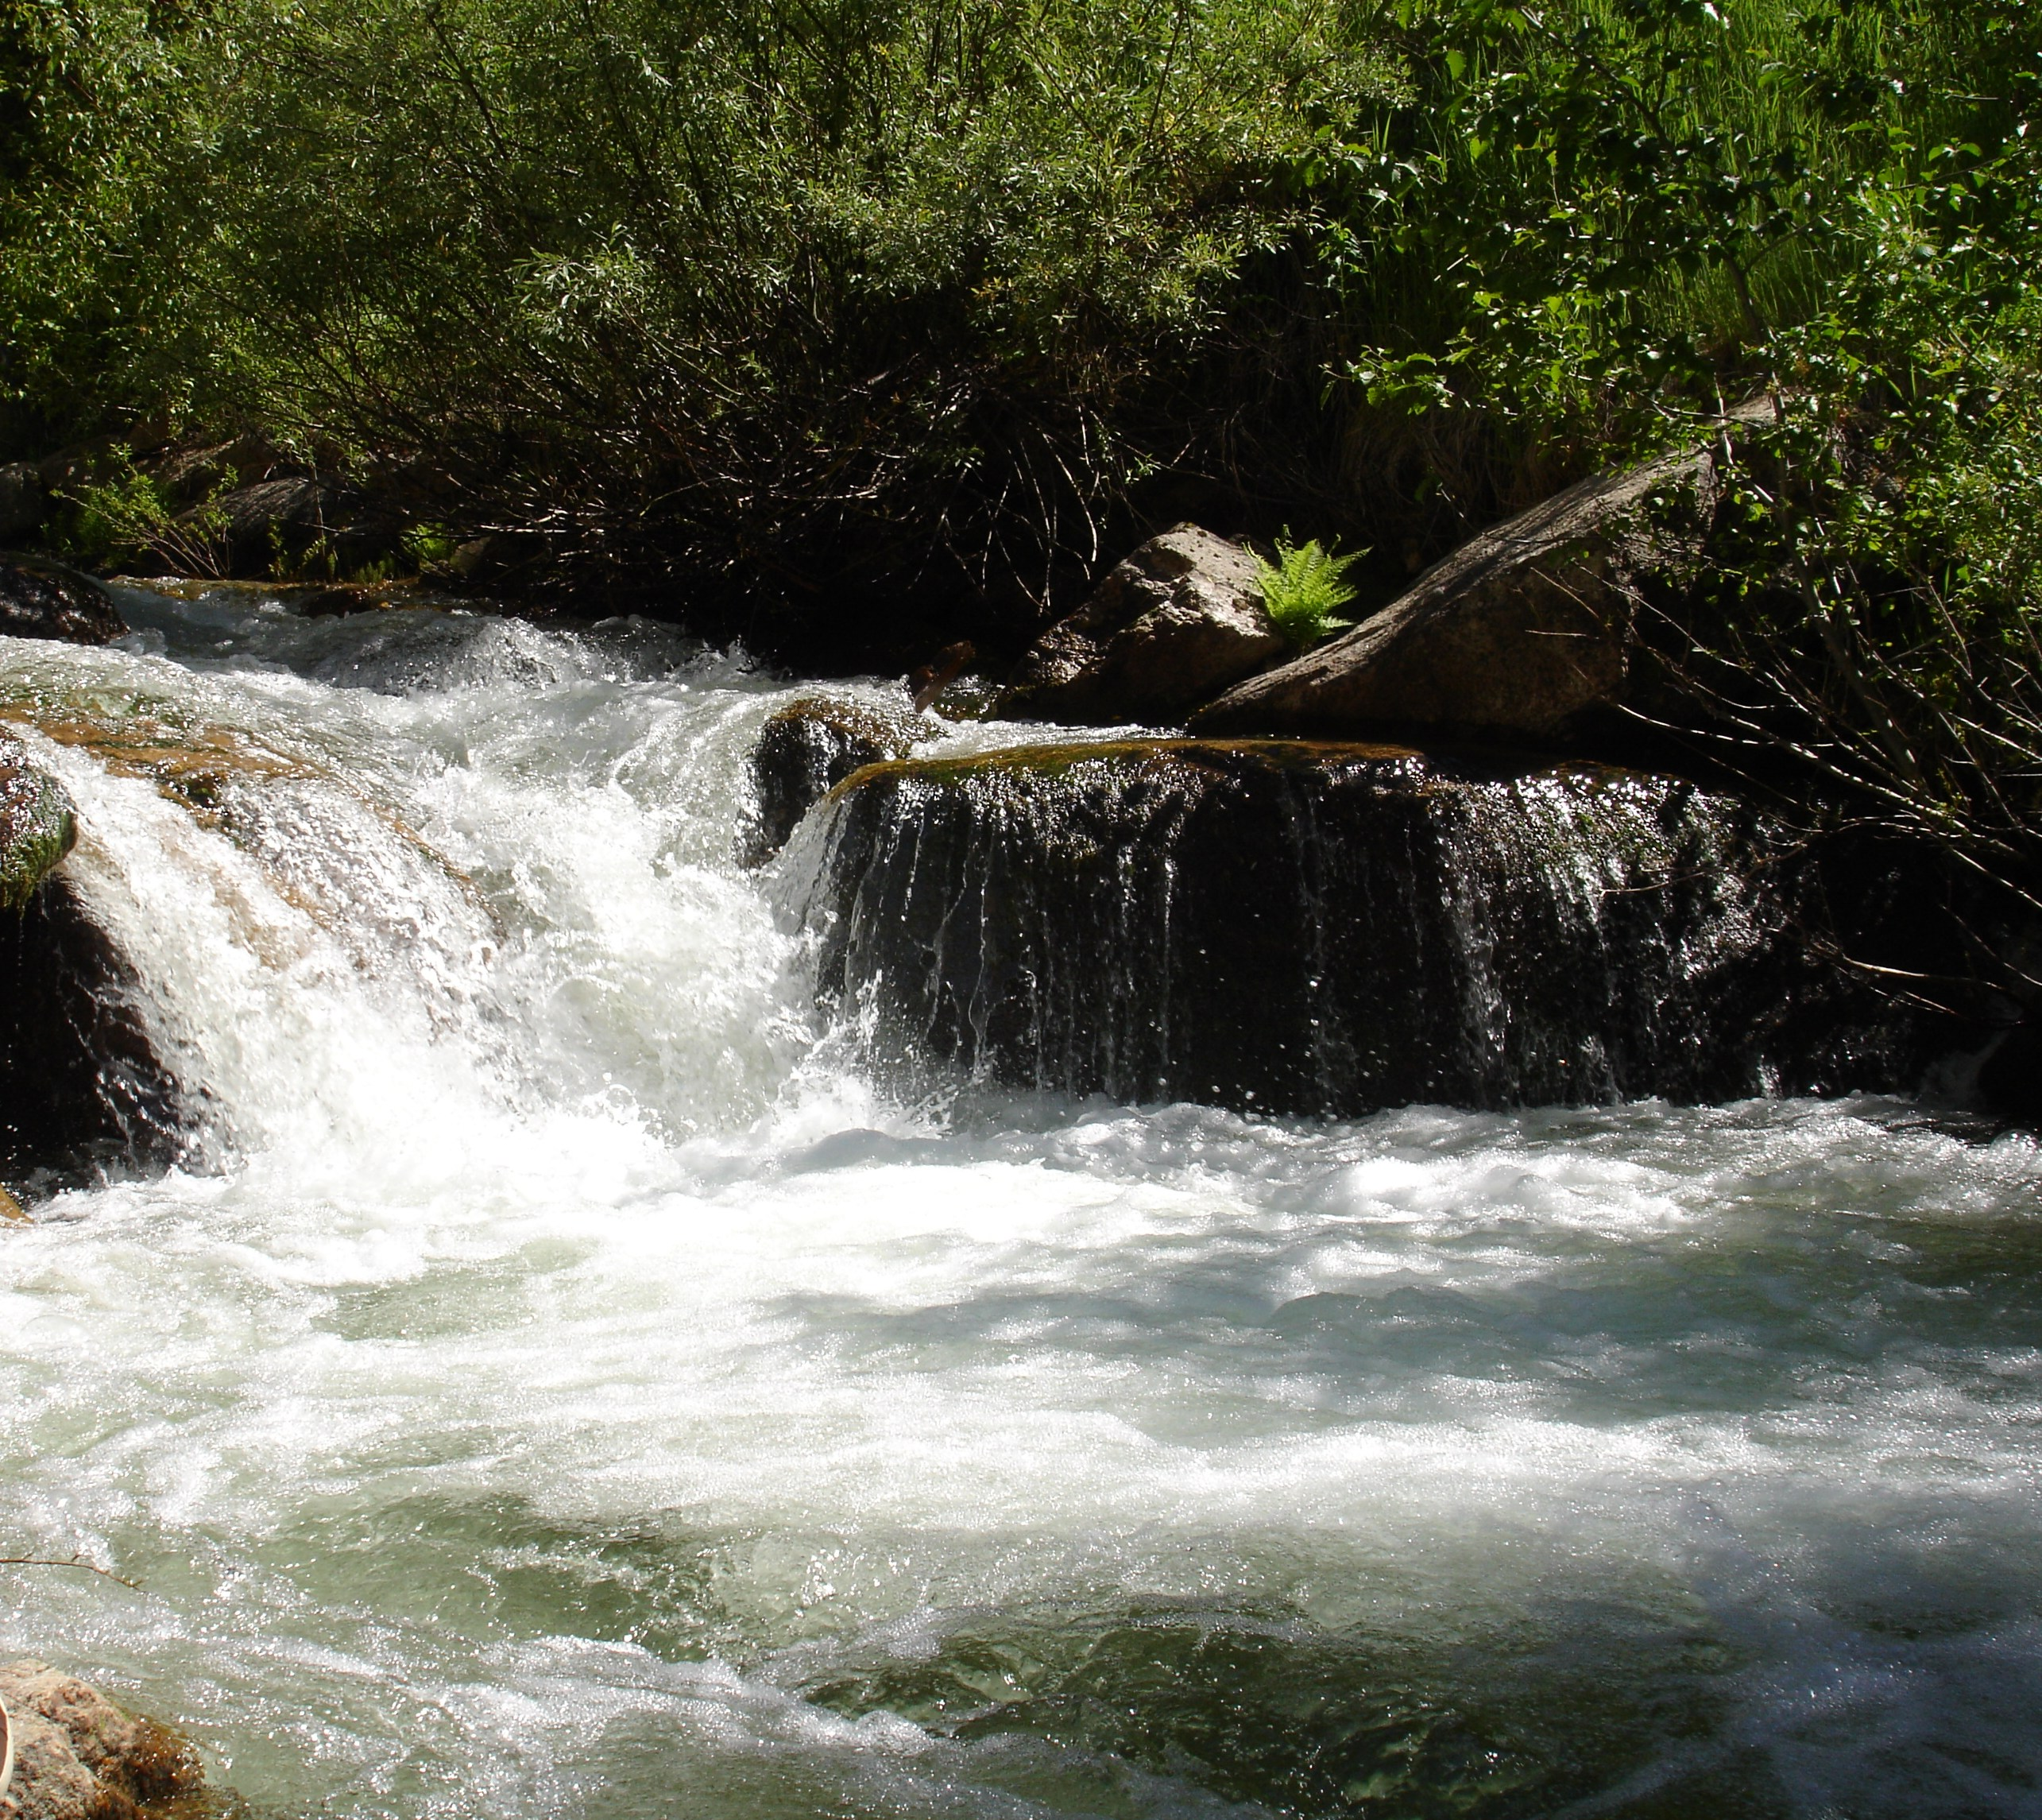
James Cefalo
208-525-7161
James.Cefalo@idwr.idaho.gov

